Slide 1
The Performance of FBMC-SS in Challenging HF Channel Conditions
Brandon Hunt, Thomas Cameron Sego,
David B. Haab, Thomas V. Holschuh,
Hussein Moradi, and Behrouz Farhang-Boroujeny
Idaho National Laboratory and The University of Utah

Slide 2
Outline
Provide overview of FBMC-SS waveform
  Transmitter structure
  NMF-based receiver structure
  Discuss spectrum and bandwidth
Present simulated results in challenging channel environments
  Cases:
    2 path channel with 2nd path frequency offset
    2 path mid-latitude disturbed and “very poor” channels
    Large narrowband interferer
    Highly congested interference case
    Highly dynamic interference case
Conclusion

Slide 3
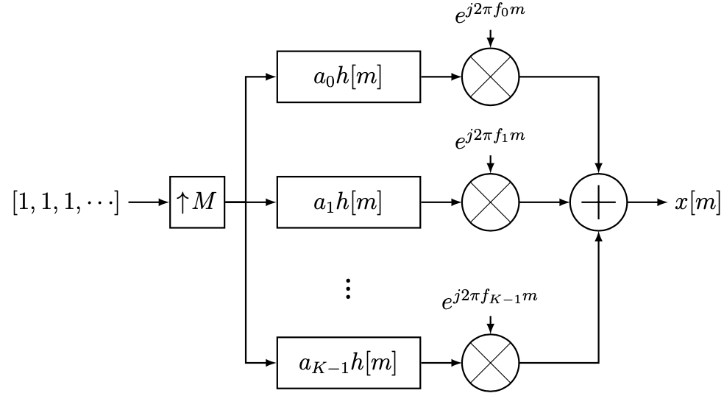

FBMC-SS transmitter
Filter bank multicarrier spread-spectrum (FBMC-SS)
  Symbols spread over $K$ non-overlapping adjacent subcarriers
  Waveform can be optimized to have low PAPR ($PAPR<4.5 dB$)
Figure 1: FBMC-SS transmitter structure

Slide 4
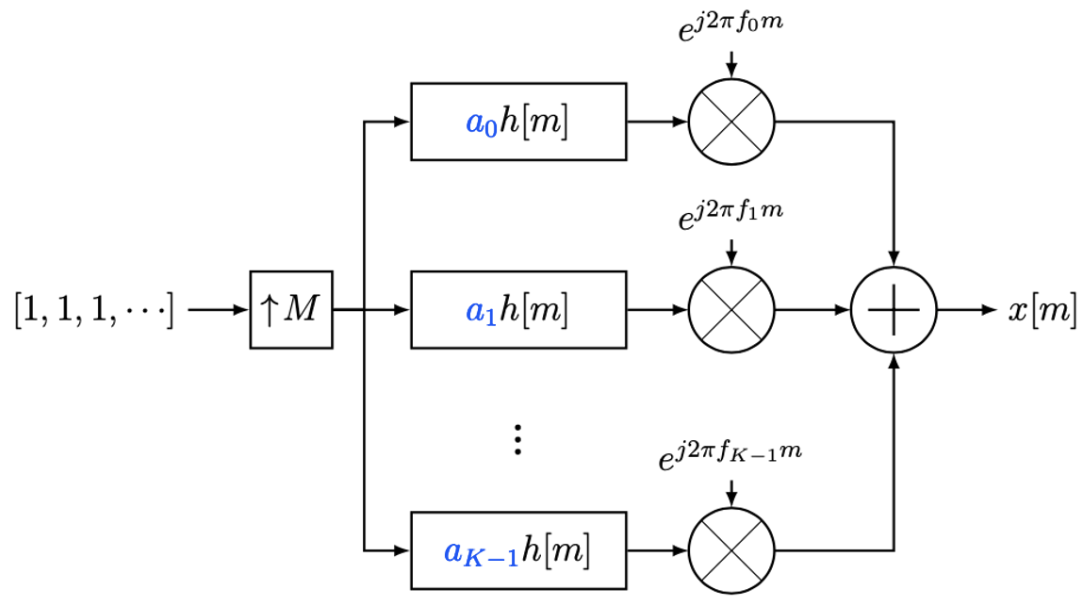
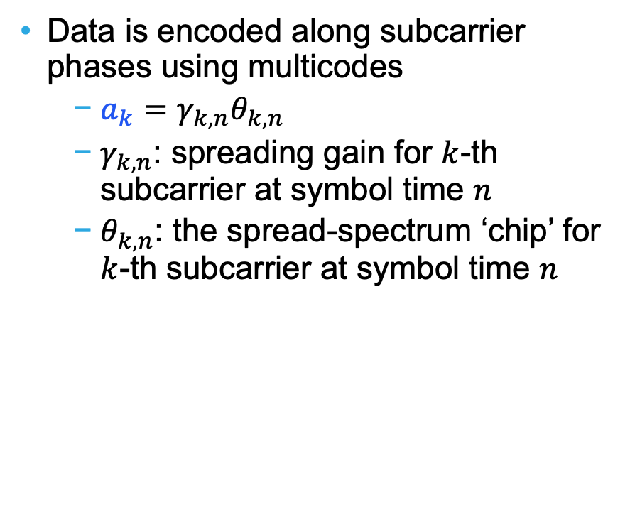
FBMC-SS transmitter
Data is encoded along subcarrier phases using multicodes
  $a_{k}=γ_{k, n}θ_{k, n}$
  $γ_{k,n}$: spreading gain for $k$-th subcarrier at symbol time $n$
  $θ_{k, n}$: the spread-spectrum ‘chip’ for $k$-th subcarrier at symbol time $n$
Figure 1: FBMC-SS transmitter structure;
multicode ‘chips’ are written in blue.

Slide 5
FBMC-SS receiver
Normalized Matched-Filter (NMF) [1]
  Matched filtering with blind subcarrier normalization
  Blindly approximates maximum ratio combining
Improved packet detection in presence of high partial-band interference
Efficient implementation with overlap-add method
Figure 2: Basic NMF Receiver structure
[1] D. B. Haab, H. Moradi, and B. Farhang-Boroujeny, "Spread Spectrum Symbol Detection With Blind Interference Suppression in FBMC-SS," in IEEE Open Journal of the Communications Society, vol. 2, pp. 1630 1646, 2021, doi: 10.1109/OJCOMS.2021.3090356.

Slide 6
FBMC-SS receiver
Additional receiver details:
  Preamble detector tests multiple candidate Carrier Frequency Offsets (CFO)
    This improves packet detection in presence of large CFO
  Inserted pilots allow for detection of additional modes of propagation
  Different spreading gains applied to each symbol reduce the impact of inter-symbol interference (ISI)

Slide 7
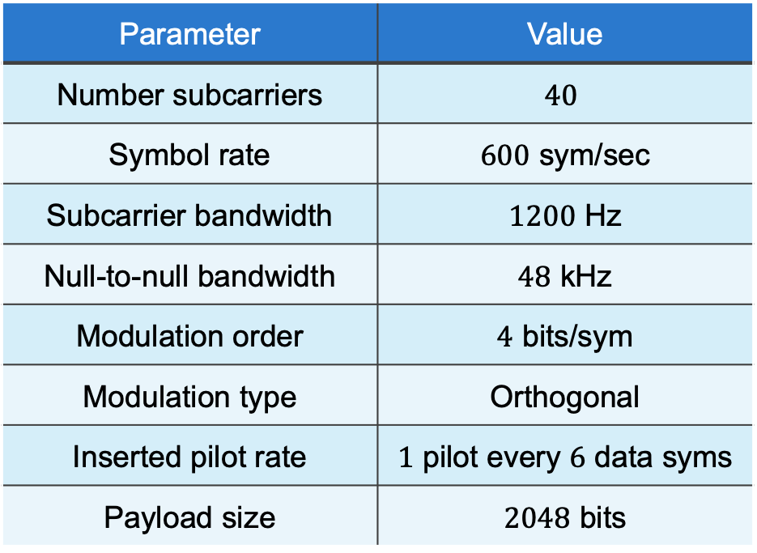
FBMC-SS waveform parameters
Parameters chosen based on [2] to match MIL-STD-188-110D, WFID 0 (Walsh), 48 kHz waveform
  Direct sequence spread-spectrum
Receiver given no channel information; same receiver settings used for each case
Table 1: Waveform parameters
Parameter | Value
Number subcarriers | $$40$$
Symbol rate | $600$ sym/sec
Subcarrier bandwidth | $1200$ Hz
Null-to-null bandwidth | $48$ kHz
Modulation order | $4$ bits/sym
Modulation type | Orthogonal
Inserted pilot rate | $1$ pilot every $6$ data syms
Payload size | $2048$ bits
[2] J. Nieto, W. Furman, W. Batts, “A Comparison of Published Waveform Design Techniques Used for Reliable HF Communications,” Proceedings of the Nordic HF Conference HF22, 2022.

Slide 8
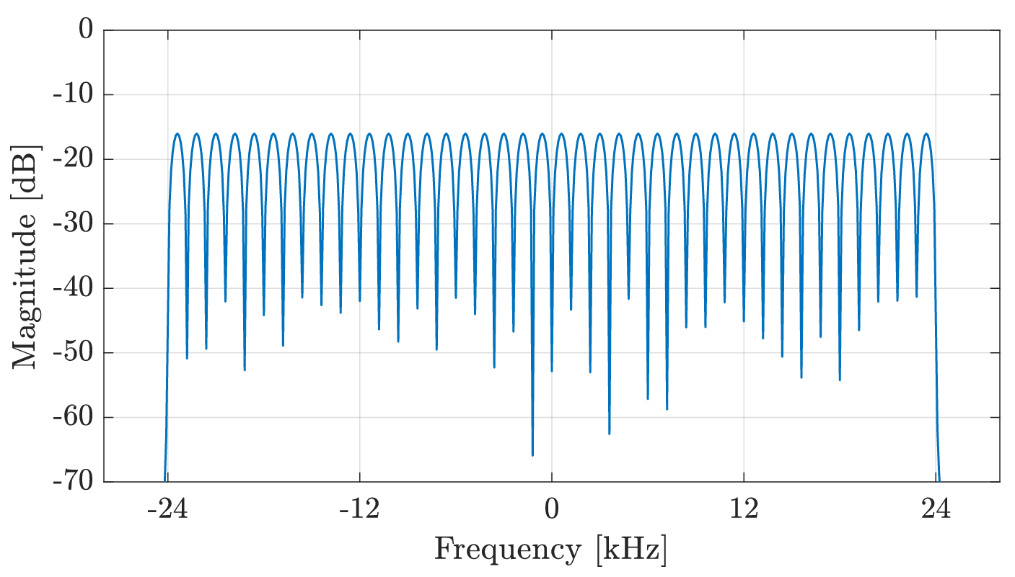
FBMC-SS waveform parameters
Table 1: Waveform parameters
Parameter | Value
Number subcarriers | $$40$$
Symbol rate | $600$ sym/sec
Subcarrier bandwidth | $1200$ Hz
Null-to-null bandwidth | $48$ kHz
Modulation order | $4$ bits/sym
Modulation type | Orthogonal
Inserted pilot rate | $1$ pilot every $6$ data syms
Payload size | $2048$ bits
Figure 3: Frequency response of transmit pulse-shaping filter with parameters given in Table 1

Slide 9
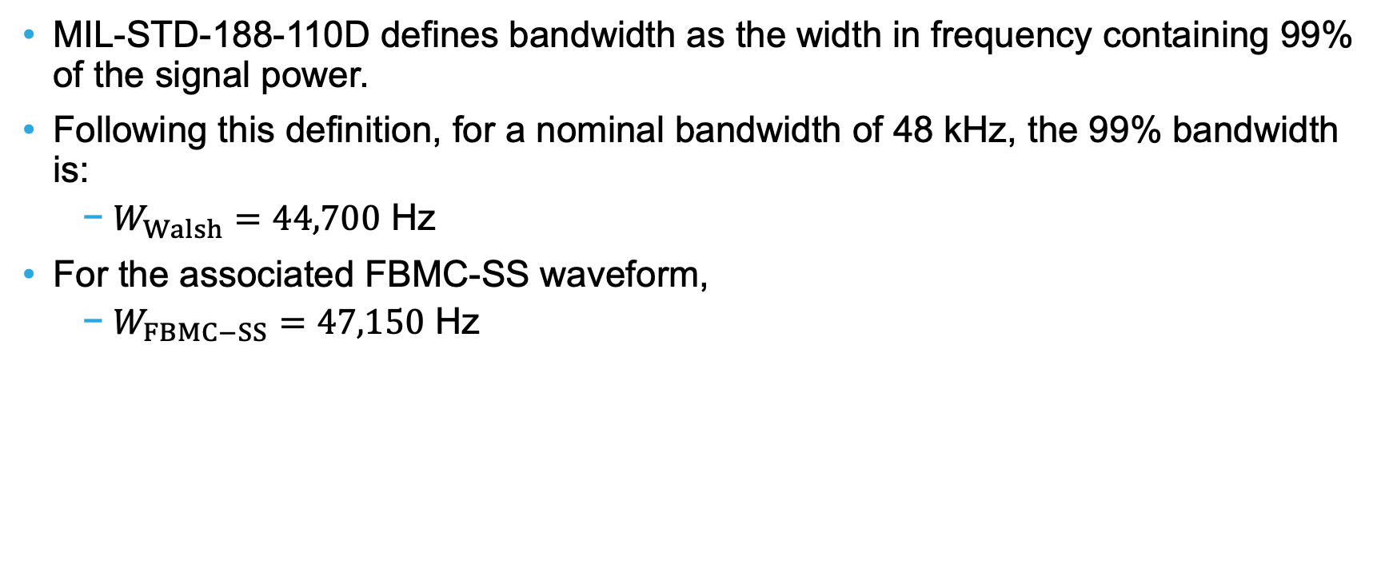
Bandwidths
MIL-STD-188-110D defines bandwidth as the width in frequency containing 99% of the signal power.
Following this definition, for a nominal bandwidth of 48 kHz, the 99% bandwidth is:
  $W_{Walsh}=44,700$ Hz
For the associated FBMC-SS waveform,
  $W_{FBMC−SS}=47,150$ Hz

Slide 10
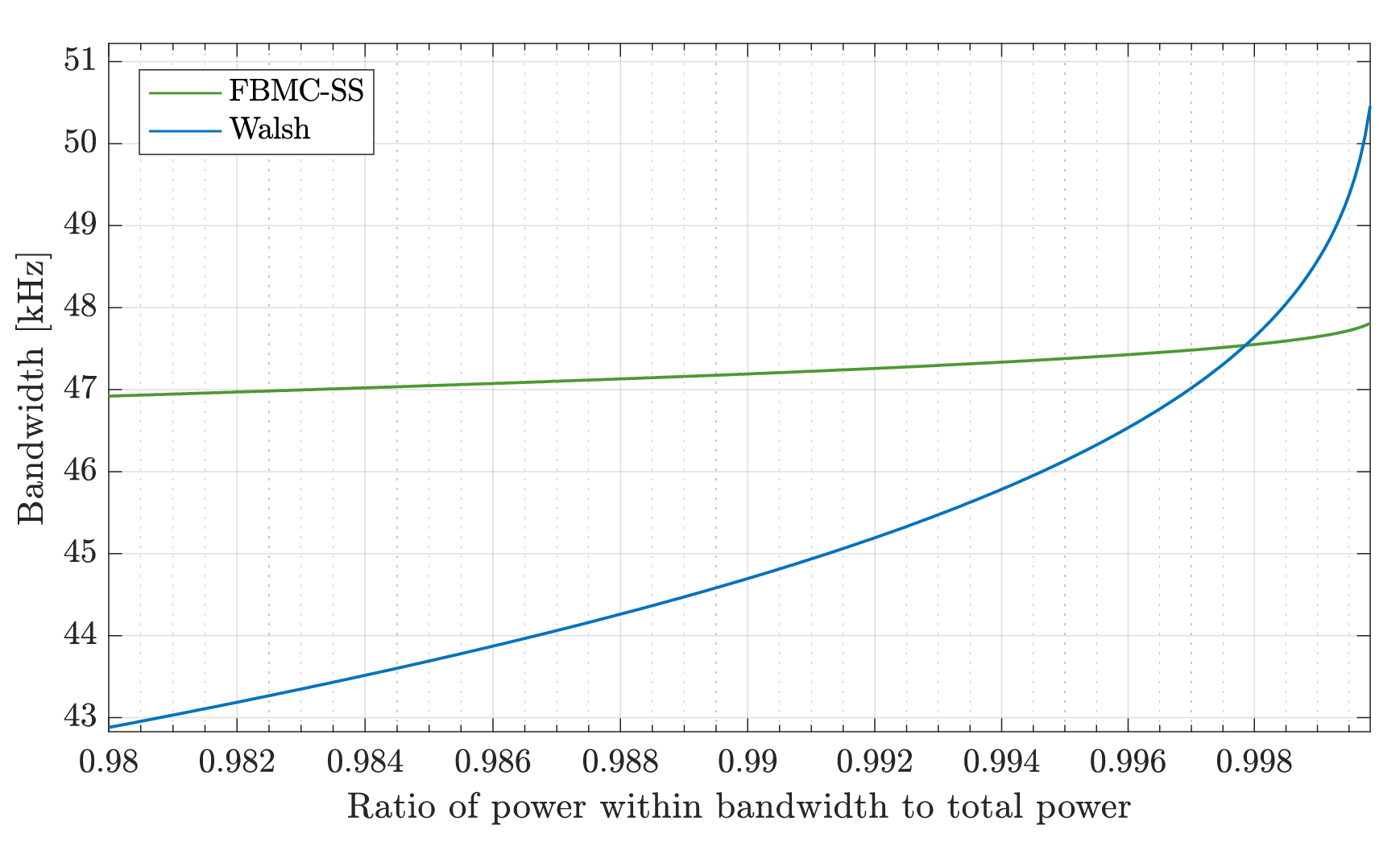
Bandwidths (cont.)
99.74% of the signal energy is contained in the same bandwidth for both waveforms
Figure 4: Signal bandwidth as function of ratio of power within bandwidth

Slide 11
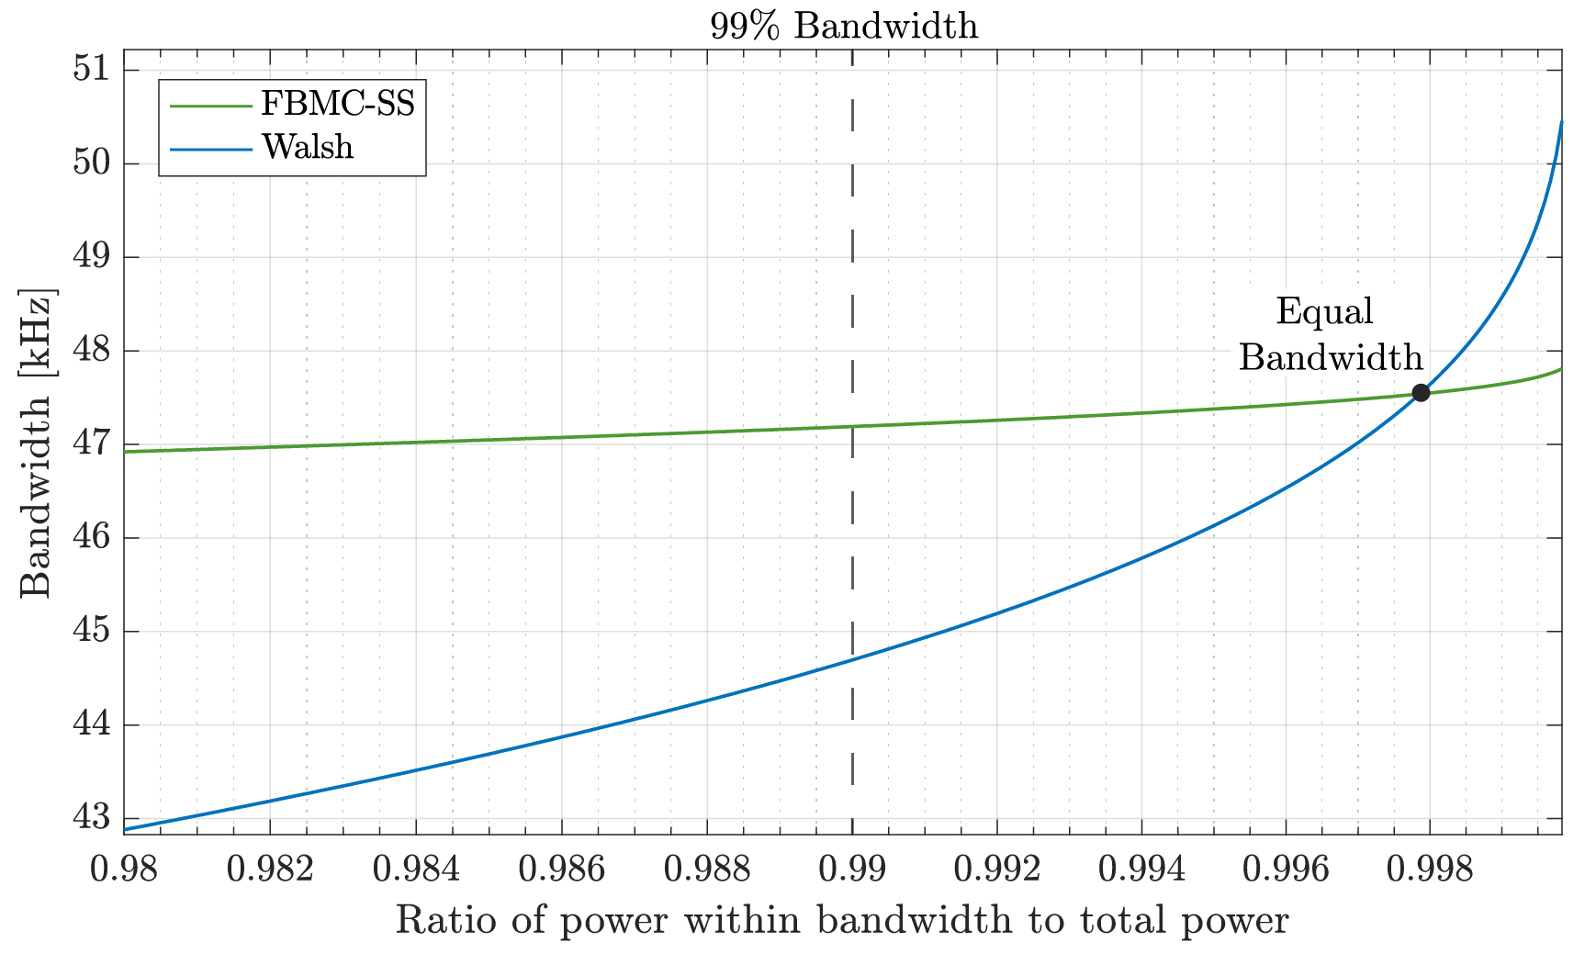

Bandwidths (cont.)
99.74% of the signal energy is contained in the same bandwidth for both waveforms
  At this point, the bandwidth is $W_{99.74\%}=47.5$ kHz
  This point remains below the nominal bandwidth of $48$ kHz
Figure 4: Signal bandwidth as function of ratio of power within bandwidth

Slide 12
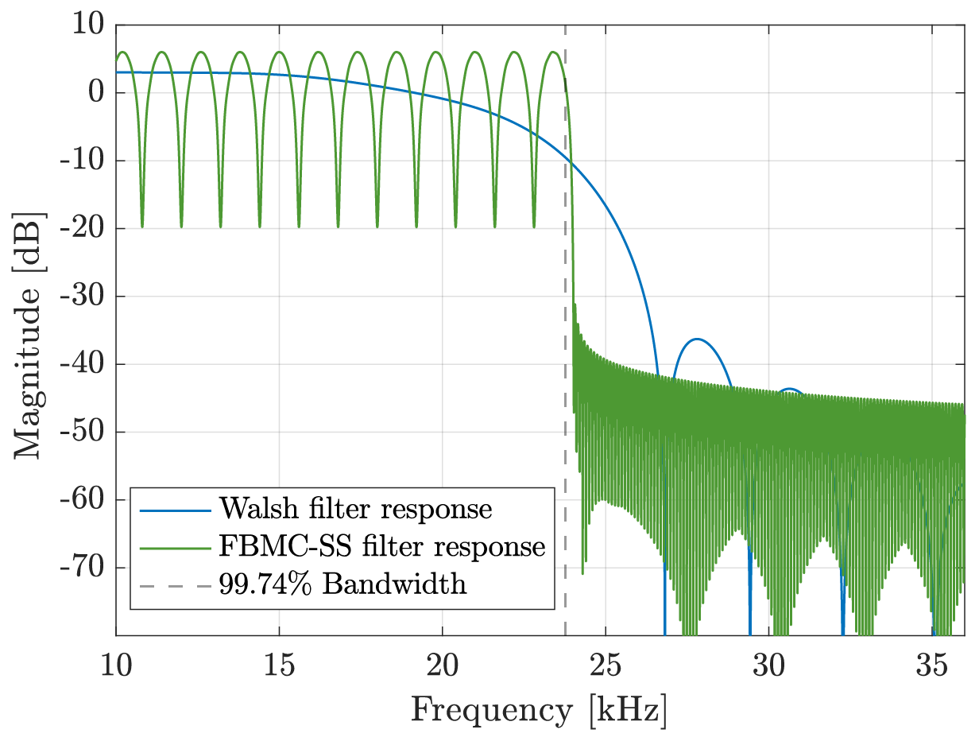

Bandwidths (cont.)
99.74% of the signal energy is contained in the same bandwidth for both waveforms
  At this point, the bandwidth is $W_{99.74\%}=47.5$ kHz
  This point remains below the nominal bandwidth of $48$ kHz
  For FBMC-SS, nearly all signal power is confined to $48$ kHz
    Improved adjacent channel rejection
Figure 5: Power spectral density of Walsh and FBMC-SS transmit pulse-shaping filters

Slide 13
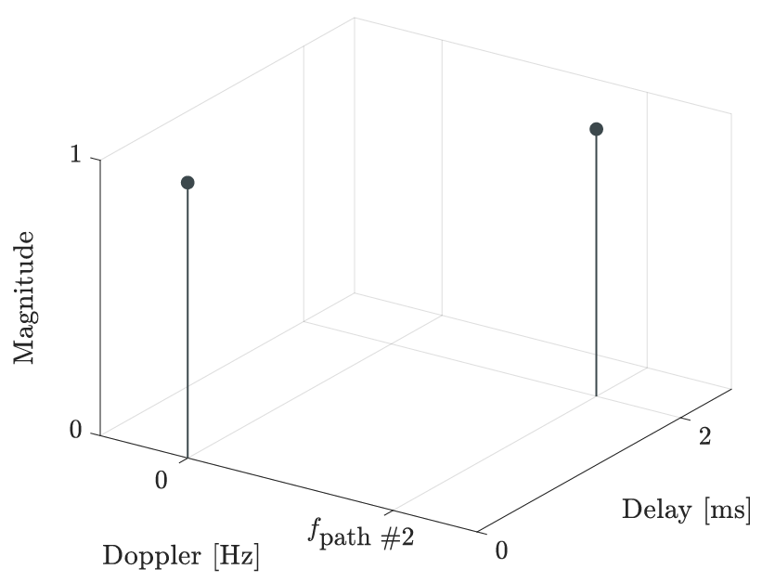

Simulated channels
Several HF channel conditions are simulated, following [2]:
  2 path frequency offset channel
    $N_{path}=2, T_{d}=2$ ms,
    $f_{path \#2}=\left\{0, 1, 10, 25\right\} \text{Hz}$
Figure 6: Delay-Doppler representation of 2 path, frequency offset channel

Slide 14
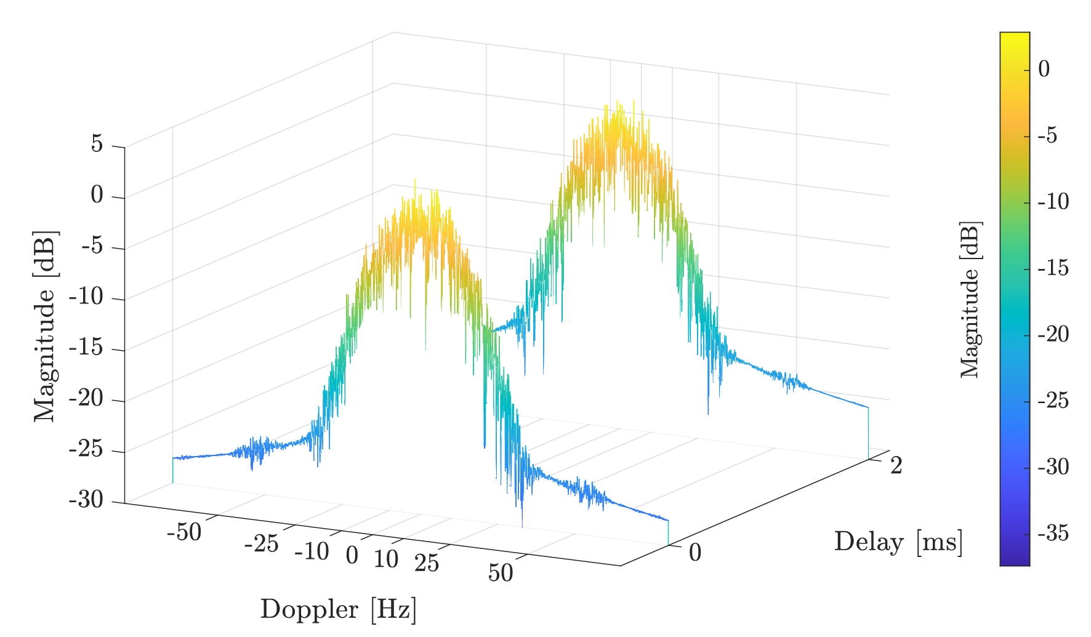
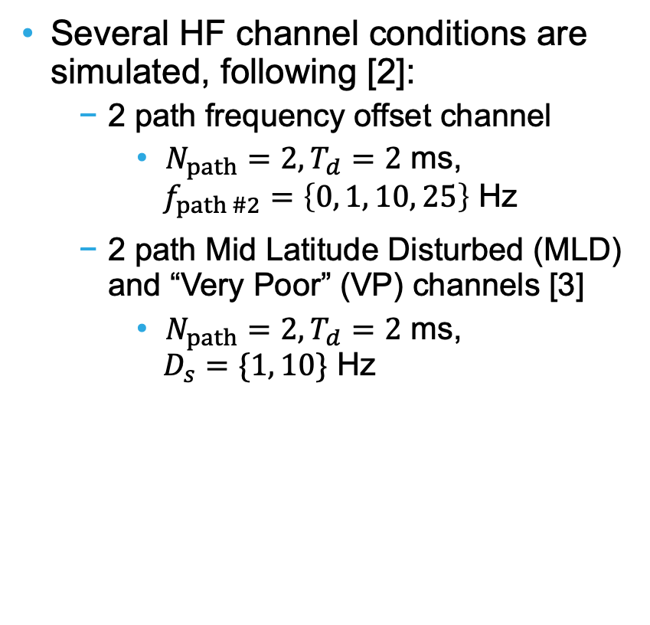
Simulated channels
Several HF channel conditions are simulated, following [2]:
  2 path frequency offset channel
    $N_{path}=2, T_{d}=2$ ms,
    $f_{path \#2}=\left\{0, 1, 10, 25\right\} \text{Hz}$
  2 path Mid Latitude Disturbed (MLD) and “Very Poor” (VP) channels [3]
    $N_{path}=2, T_{d}=2$ ms,
    $D_{s}=\{1, 10\}$ Hz
Figure 7: Delay-Doppler representation of VP channel
[3] ITU-R Recommendation F.1487, “Testing of HF modems with bandwidths of up to about 12 kHz using
Ionospheric channel simulators,” 2000

Slide 15
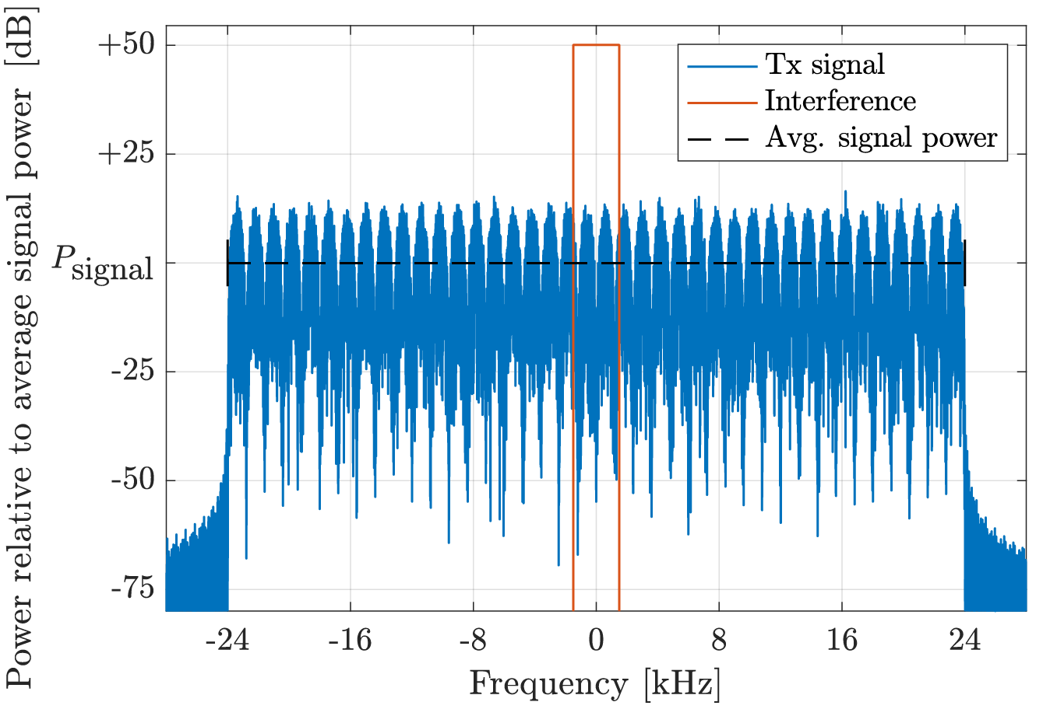
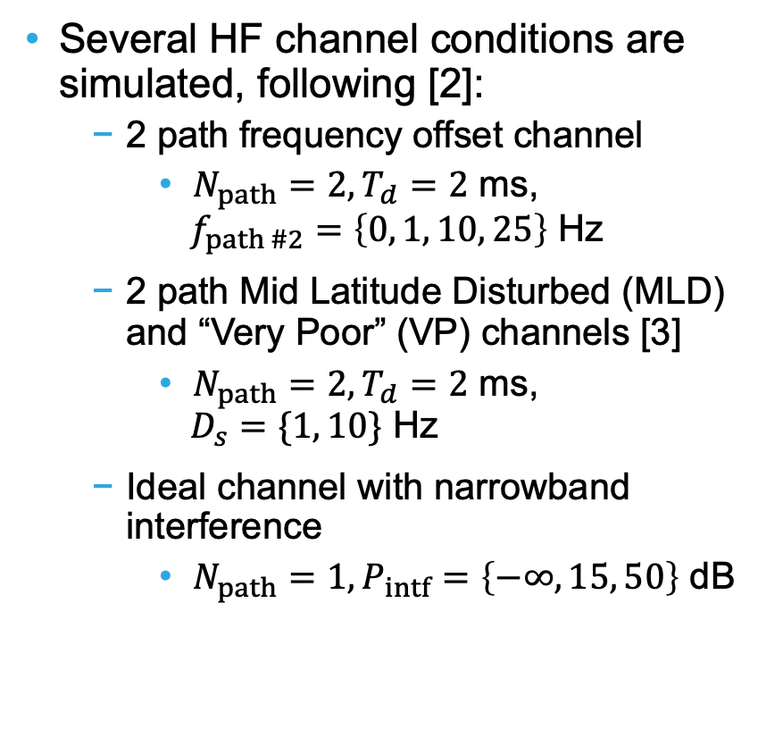
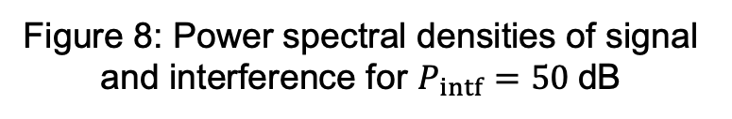
Simulated channels
Several HF channel conditions are simulated, following [2]:
  2 path frequency offset channel
    $N_{path}=2, T_{d}=2$ ms,
    $f_{path \#2}=\left\{0, 1, 10, 25\right\}$ Hz
  2 path Mid Latitude Disturbed (MLD) and “Very Poor” (VP) channels [3]
    $N_{path}=2, T_{d}=2$ ms,
    $D_{s}=\{1, 10\}$ Hz
  Ideal channel with narrowband interference
    $N_{path}=1, P_{intf}=\left\{−∞, 15, 50\right\}$ dB
Figure 8: Power spectral densities of signal and interference for $P_{intf}=50$dB

Slide 16
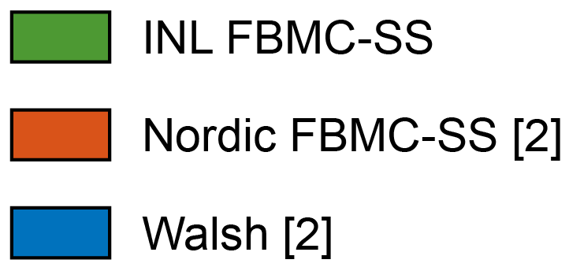
Results legend
Results for each transceiver system are color coded
Table 2: Example color-coded
table containing results
Waveform Type | Result
INL FBMC-SS | Result 1
Nordic FBMC-SS | Result 2
Walsh | Result 3

Slide 17
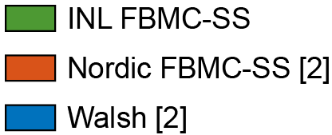
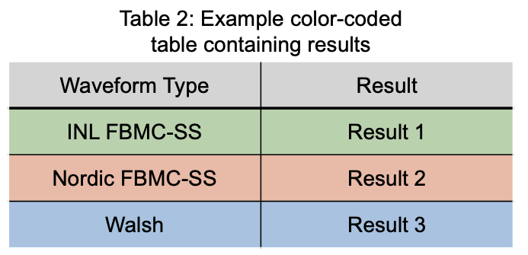
Results legend
Results for each transceiver system are color coded

Slide 18
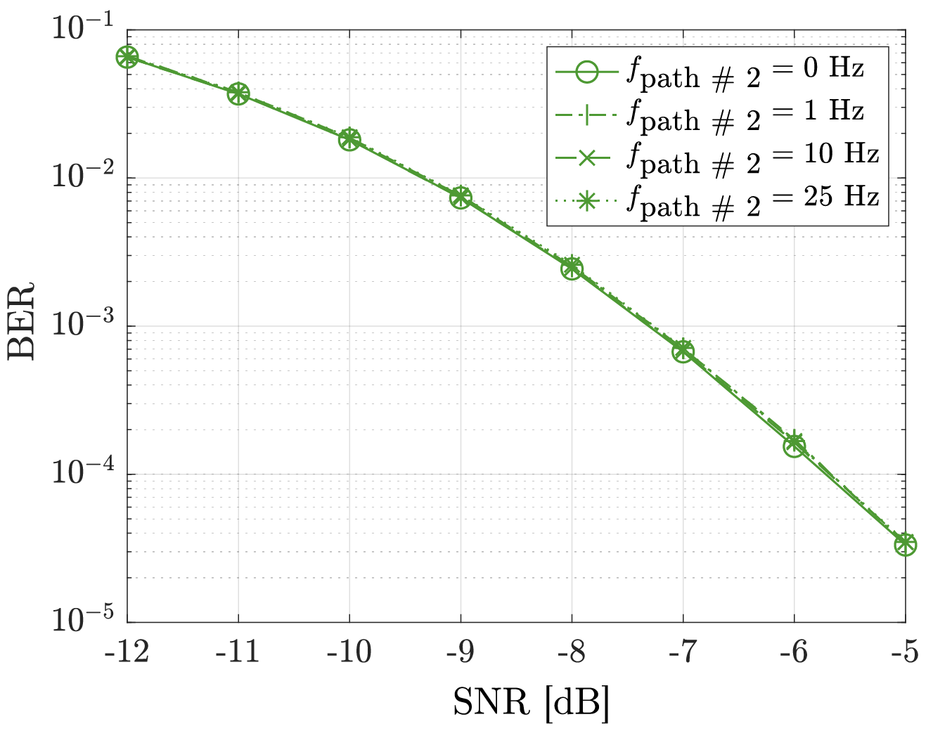
Results for 2 path, freq. offset channel
Figure 6: Delay-Doppler representation of
simulated channel
Figure 9: INL FBMC-SS waveform performance in 2 path channel with 2nd path frequency offset

Slide 19
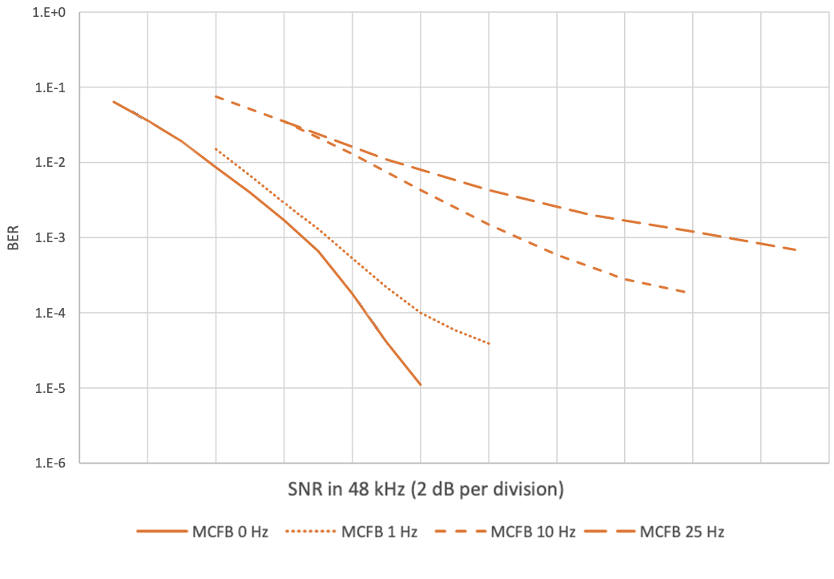
Results for 2 path, freq. offset channel
Figure 9: INL FBMC-SS waveform performance in 2 path channel with 2nd path frequency offset
Figure 10: Nordic FBMC-SS results from [2]. Results for the Walsh waveform have been removed for clarity. Note that MCFB is interchangeable with FBMC-SS

Slide 20
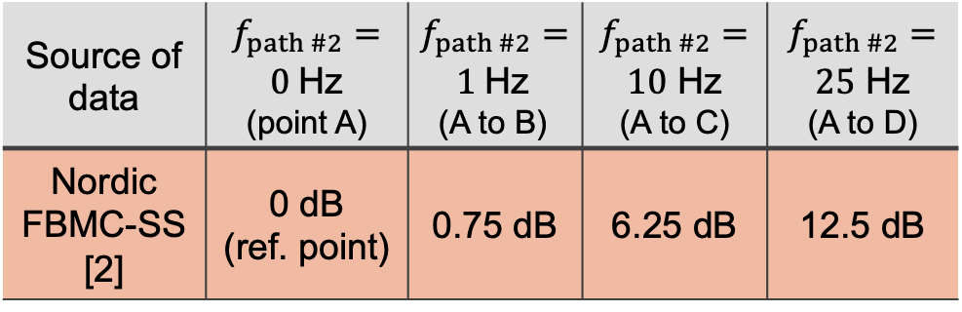

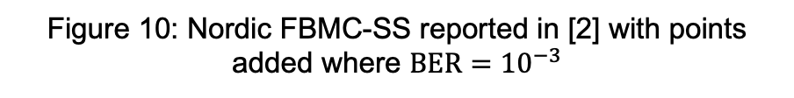
Results for 2 path, freq. offset channel
SNR penalty to achieve a $BER = {10}^{−3}$ relative to the channel $f_{path \#2}=0$ Hz
Table 3: Comparing results to [2]
Source of data | $f_{path \#2}=0$Hz (point A) | $f_{path \#2}=1$Hz (A to B) | $$f_{path \#2}=$$ $10$ Hz (A to C) | $$f_{path \#2}=$$ $25$ Hz (A to D)
Nordic FBMC-SS [2] | 0 dB (ref. point) | 0.75 dB | 6.25 dB | 12.5 dB
B
C
D
A
Figure 10: Nordic FBMC-SS reported in [2] with points added where $BER={10}^{−3}$

Slide 21
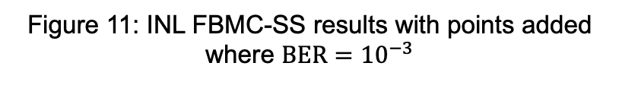
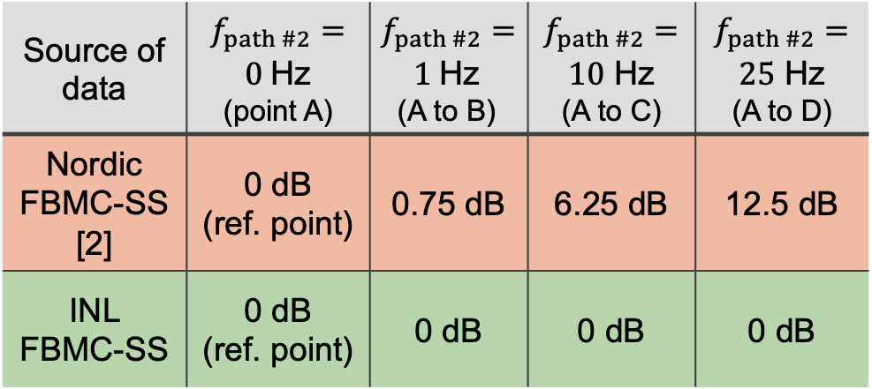
Results for 2 path, freq. offset channel
SNR penalty to achieve a $BER = {10}^{−3}$ relative to the channel $f_{path \#2}=0$ Hz
Table 3: Comparing results to [2]
Source of data | $f_{path \#2}=0$Hz (point A) | $f_{path \#2}=1$Hz (A to B) | $$f_{path \#2}=$$ $10$ Hz (A to C) | $$f_{path \#2}=$$ $25$ Hz (A to D)
Nordic FBMC-SS [2] | 0 dB (ref. point) | 0.75 dB | 6.25 dB | 12.5 dB
INL FBMC-SS | 0 dB (ref. point) | 0 dB | 0 dB | 0 dB
A, B, C, and D
Figure 11: INL FBMC-SS results with points added where $BER={10}^{−3}$

Slide 22



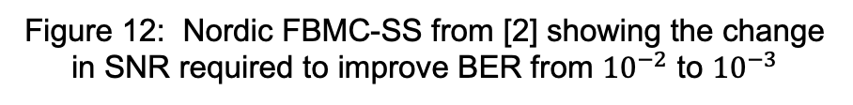
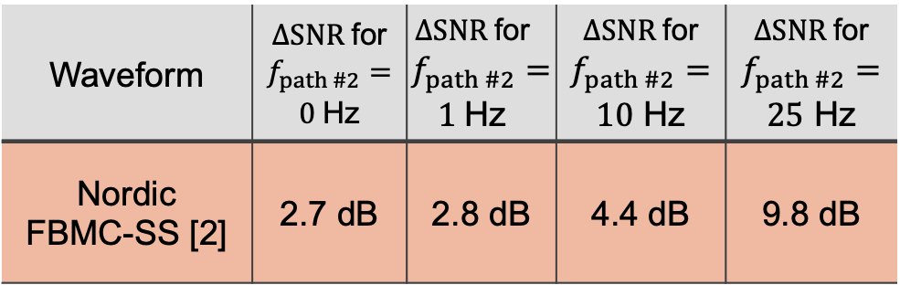
Results for 2 path, freq. offset channel
Additional SNR required to improve BER from ${10}^{−2}$ to ${10}^{−3}$
$ΔSNR$ for
$f_{path \#2 }=25$Hz
Table 4: Comparing marginal SNRs
Waveform | $ΔSNR$ for $$f_{path \#2}=$$ $0$Hz | $ΔSNR$ for $f_{path \#2}=1$Hz | $ΔSNR$ for $$f_{path \#2}=$$ $10$ Hz | $ΔSNR$ for $$f_{path \#2}=$$ $25$ Hz
Nordic FBMC-SS [2] | 2.7 dB | 2.8 dB | 4.4 dB | 9.8 dB
$ΔSNR$ for
$f_{path \#2 }=0$Hz
Figure 12: Nordic FBMC-SS from [2] showing the change in SNR required to improve BER from ${10}^{−2}$ to ${10}^{−3}$

Slide 23
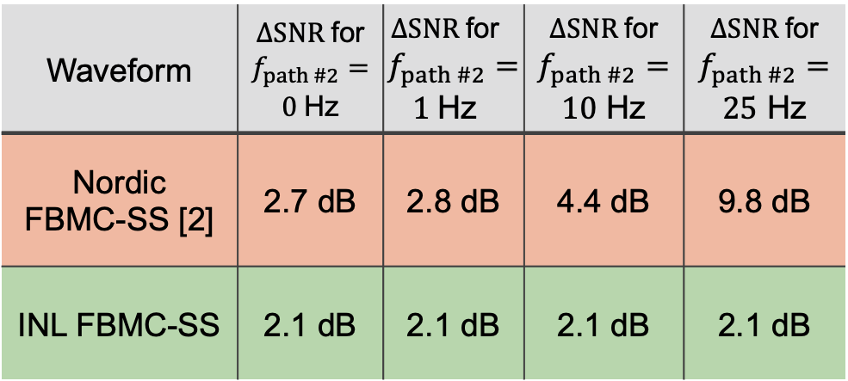

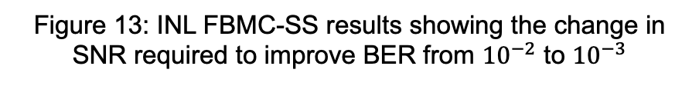
Results for 2 path, freq. offset channel
Additional SNR required to improve BER from ${10}^{−2}$ to ${10}^{−3}$
Table 4: Comparing marginal SNRs
Waveform | $ΔSNR$ for $$f_{path \#2}=$$ $0$Hz | $ΔSNR$ for $f_{path \#2}=1$Hz | $ΔSNR$ for $$f_{path \#2}=$$ $10$ Hz | $ΔSNR$ for $$f_{path \#2}=$$ $25$ Hz
Nordic FBMC-SS [2] | 2.7 dB | 2.8 dB | 4.4 dB | 9.8 dB
INL FBMC-SS | 2.1 dB | 2.1 dB | 2.1 dB | 2.1 dB
$ΔSNR$ for
$f_{path \#2 }=\{0, 1, 10, 25\}$Hz
Figure 13: INL FBMC-SS results showing the change in SNR required to improve BER from ${10}^{−2}$ to ${10}^{−3}$

Slide 24
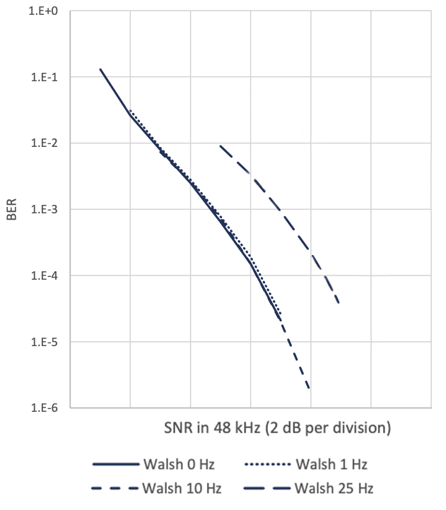


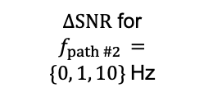
Results for 2 path, freq. offset channel
Additional SNR required to improve BER from ${10}^{−2}$ to ${10}^{−3}$
$ΔSNR$ for
$f_{path \#2 }=25$Hz
Table 5: Comparing marginal SNRs to Walsh performance in [2]
Waveform | $ΔSNR$ for $$f_{path \#2}=$$ $0$Hz | $ΔSNR$ for $f_{path \#2}=1$Hz | $ΔSNR$ for $$f_{path \#2}=$$ $10$ Hz | $ΔSNR$ for $$f_{path \#2}=$$ $25$ Hz
Walsh reported in [2] | 1.9 dB | 1.9 dB | 1.9 dB | 2.0 dB
INL FBMC-SS | 2.1 dB | 2.1 dB | 2.1 dB | 2.1 dB
$ΔSNR$ for
$$f_{path \#2 }=$$
$\{0, 1, 10\}$Hz
Figure 14: Walsh waveform performance reported in [2]. Lines are added depicting marginal SNR

Slide 25

Results for MLD and VP channels
2 channels with Doppler spreads are simulated
  Mid latitude disturbed (MLD)
    $D_{s}=1$ Hz
  Very Poor (VP)
    $D_{s}=10$ Hz
Figure 7: Delay-Doppler representation of
simulated “Very Poor” (VP) channel

Slide 26
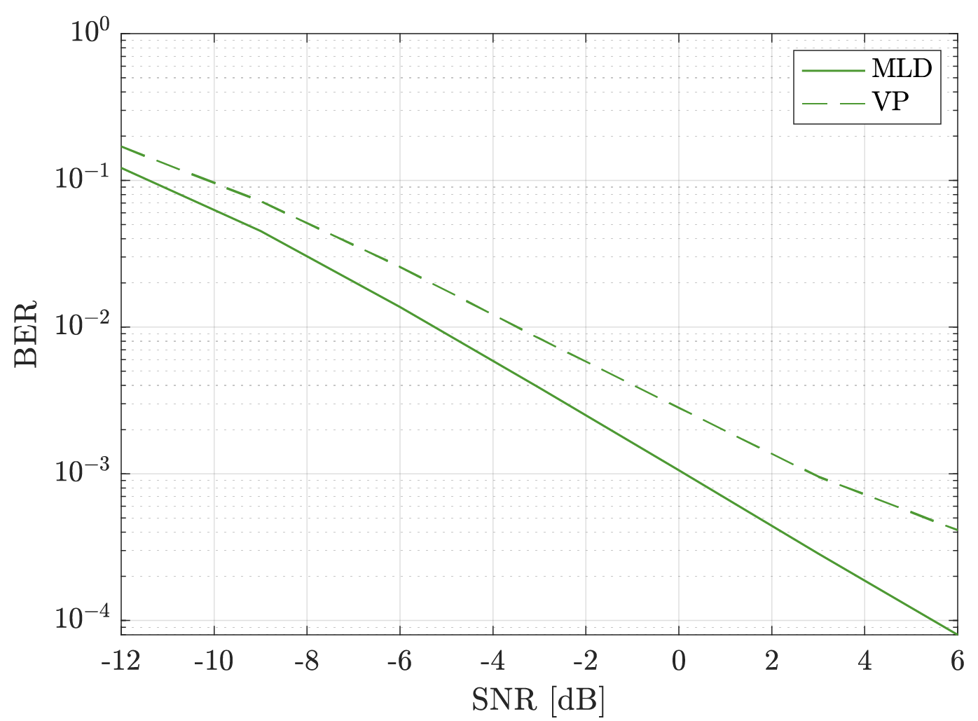
Results for MLD and VP channels
Figure 7: Delay-Doppler representation of
simulated “Very Poor” (VP) channel
Figure 15: MLD and VP performance of INL FBMC-SS implementation

Slide 27
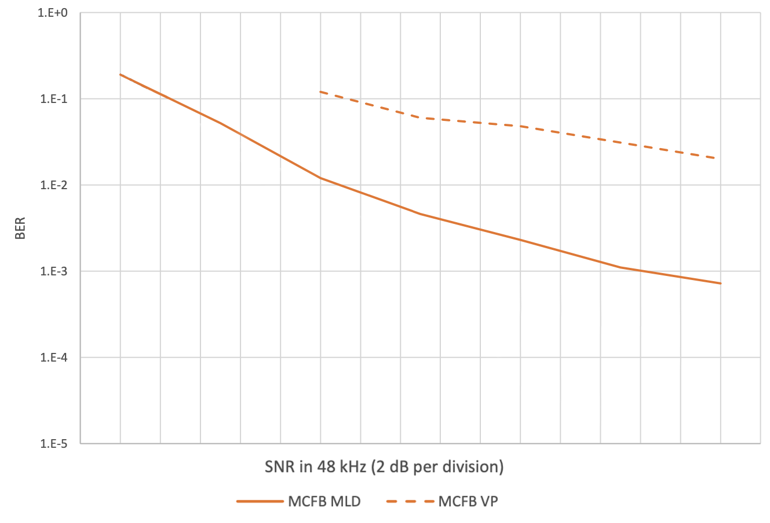
Results for MLD and VP channels
Figure 15: MLD and VP performance of INL FBMC-SS implementation
Figure 16: Nordic FBMC-SS performance for MLD and VP channels reported in [2]. Walsh results removed for clarity.

Slide 28
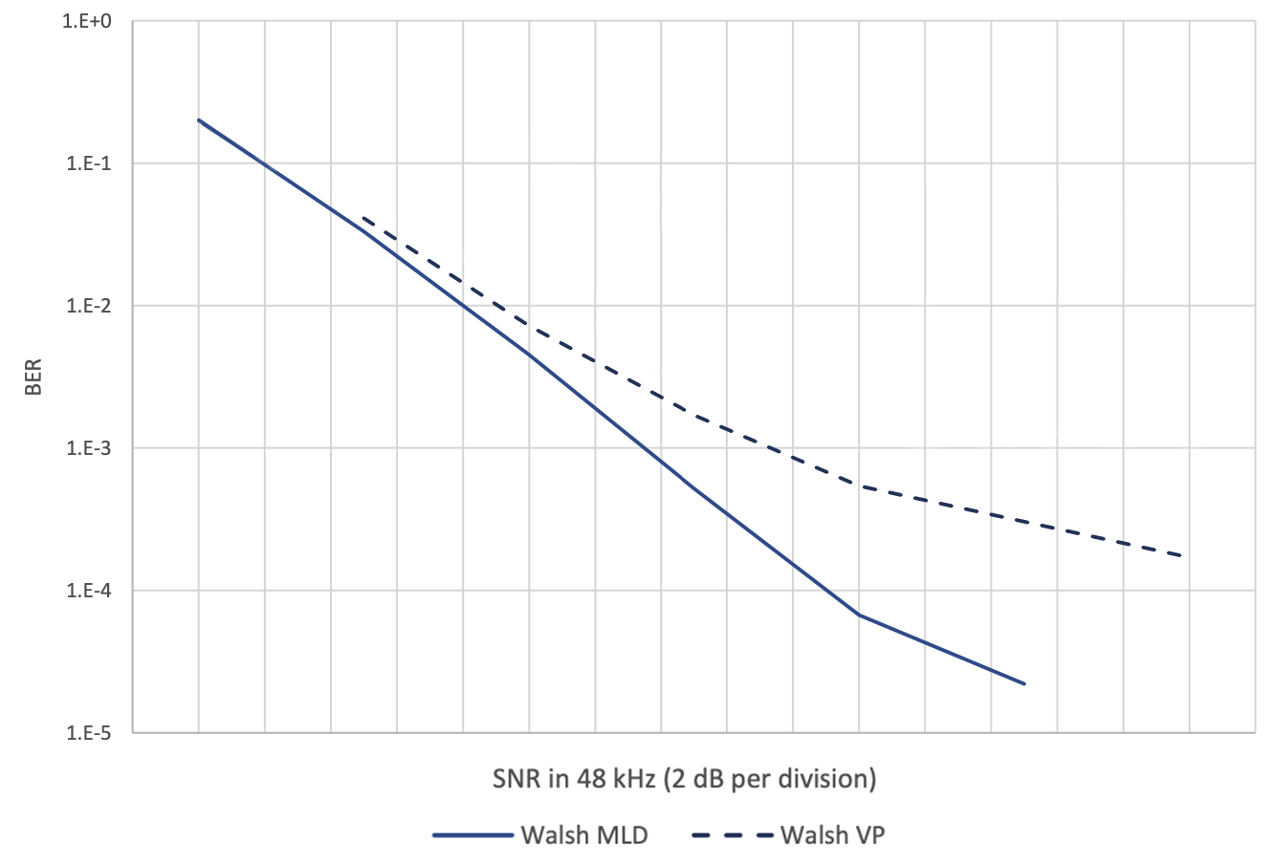
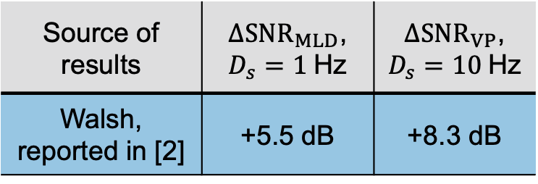
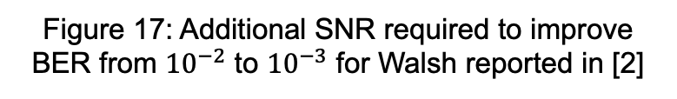


Results for MLD and VP channels
Table 6: Comparing results of Walsh performance to our FBMC-SS performance
$$Δ{SNR}_{VP}≅8.3 dB$$
Source of results | $Δ{SNR}_{MLD}$, $D_{s}=1$Hz | $Δ{SNR}_{VP}$, $D_{s}=10$Hz
Walsh, reported in [2] | +5.5 dB | +8.3 dB
$$Δ{SNR}_{MLD}≅5.5 dB$$
Figure 17: Additional SNR required to improve BER from ${10}^{−2}$ to ${10}^{−3}$ for Walsh reported in [2]

Slide 29
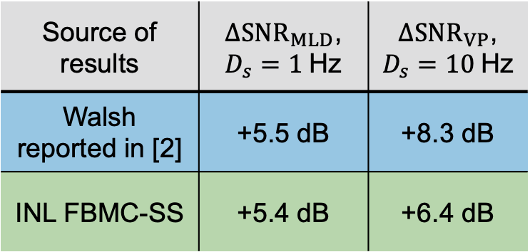
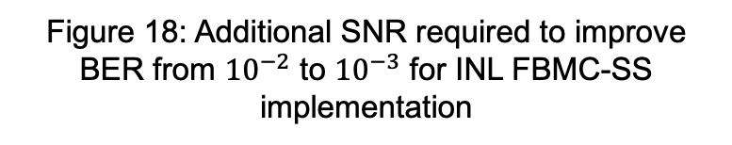


Results for MLD and VP channels
Table 6: Comparing results of Walsh performance to our FBMC-SS performance
Source of results | $Δ{SNR}_{MLD}$, $D_{s}=1$Hz | $Δ{SNR}_{VP}$, $D_{s}=10$Hz
Walsh reported in [2] | +5.5 dB | +8.3 dB
INL FBMC-SS | +5.4 dB | +6.4 dB
$$Δ{SNR}_{VP}≅6.4 dB$$
$$Δ{SNR}_{MLD}≅5.4 dB$$
Figure 18: Additional SNR required to improve BER from ${10}^{−2}$ to ${10}^{−3}$ for INL FBMC-SS implementation

Slide 30

Narrowband interference test case
AWGN channel with interferer
Interferer has a constant power spectral density = $P_{intf}$ dB greater than the average signal energy.
Following results test $P_{intf}=\left\{−∞, 15, 50\right\}$ dB
Figure 8: Depiction of interference power relative to signal in the frequency domain

Slide 31
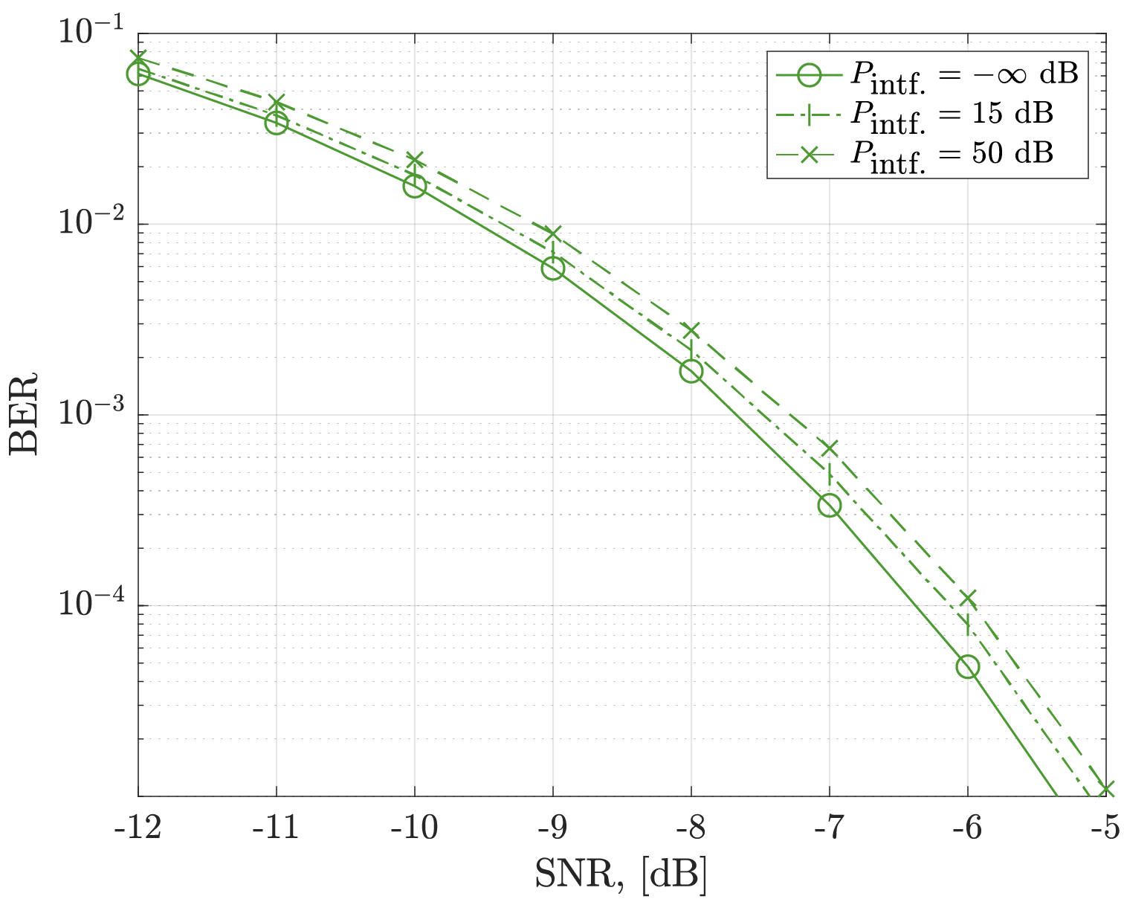
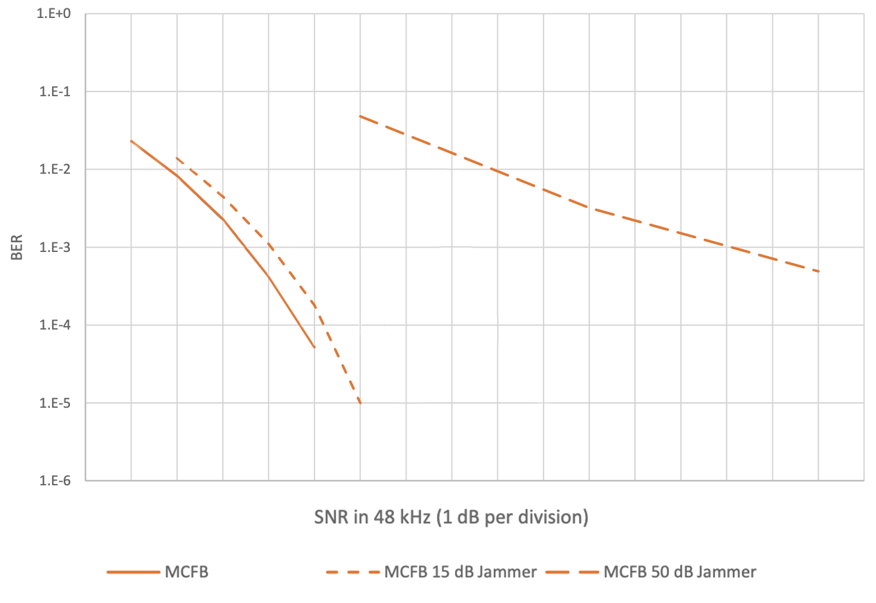
Results with Narrowband interference
Figure 19: INL FBMC-SS performance results with varying levels of interference power
Figure 20: Nordic FBMC-SS results reported in [2] with varying levels of interference power. Walsh removed.

Slide 32
Results with Narrowband interference
The NMF operation greatly reduces the impact of interference
Figure 19: INL FBMC-SS performance results with varying levels of interference power

Slide 33
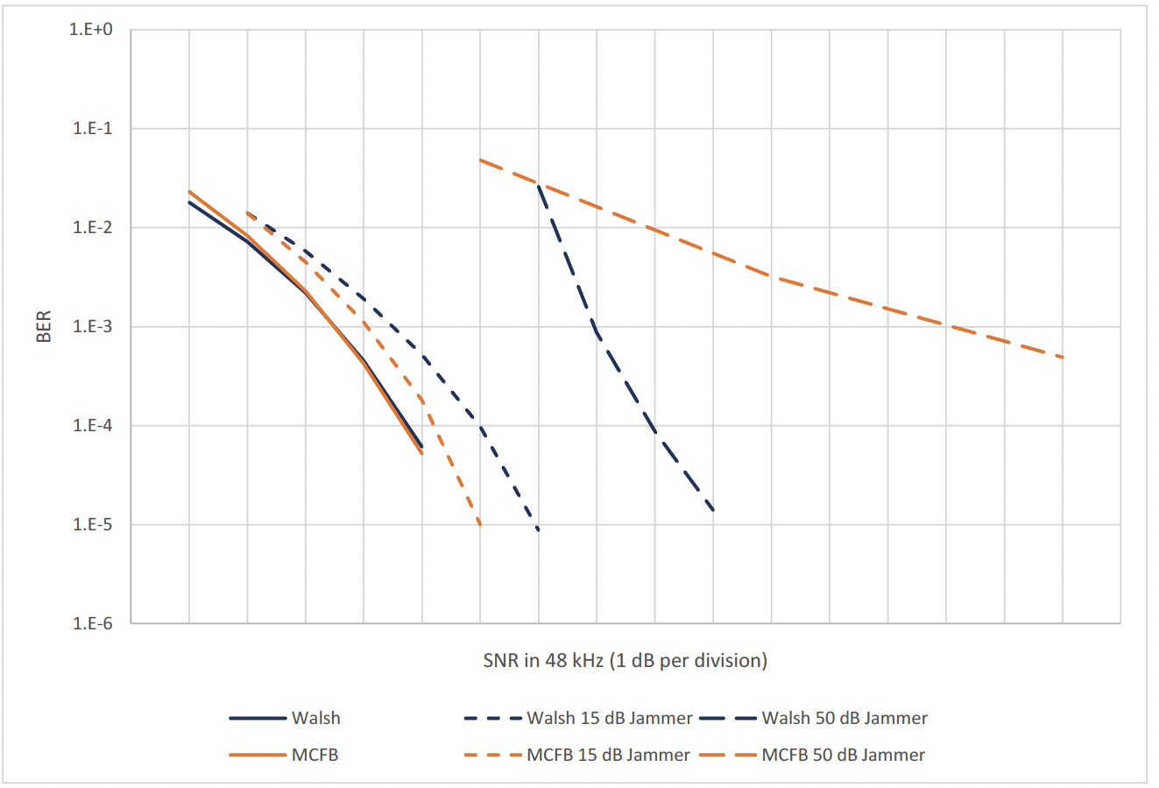
Comparing results by matching AWGN
To compare with the Walsh reported in [2], the plots can be overlaid
Figure 21: Performance results of Walsh and Nordic FBMC-SS presented in [2]

Slide 34
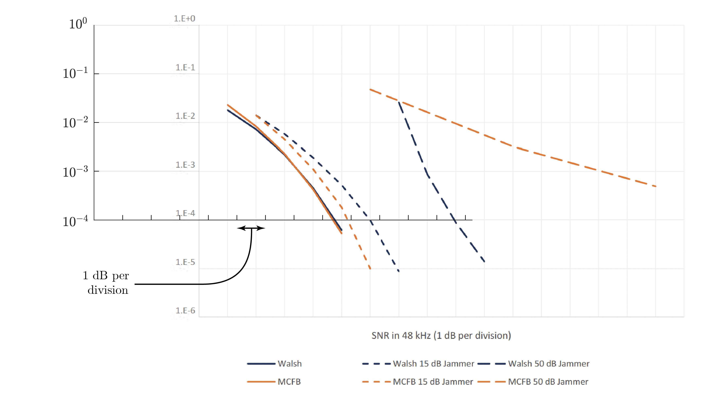
Comparing results by matching AWGN
Figure 22: Fit our axes to figure 4 in [2]

Slide 35
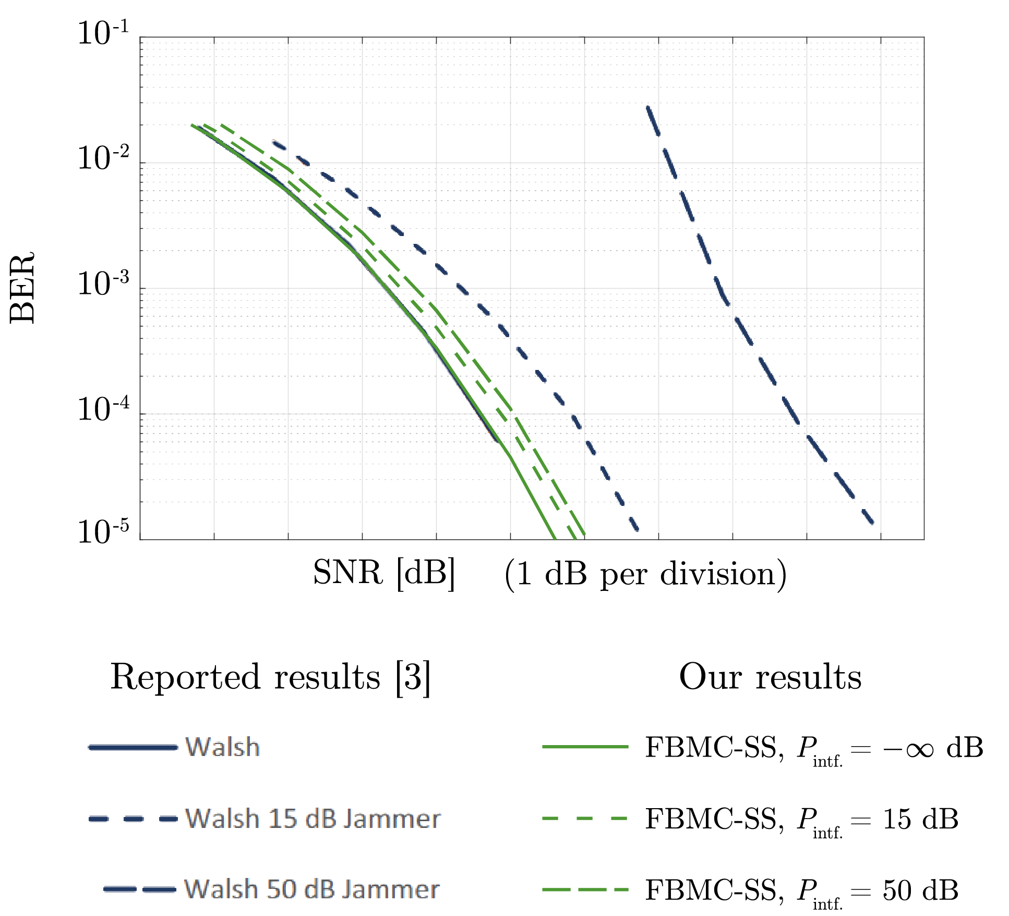
Comparing results by matching AWGN
[2]
Figure 23: Walsh performance reported in [2] compared against our INL FBMC-SS performance in the presence of narrowband interference

Slide 36


Comparing results by matching AWGN
Table 7: SNR loss at BER = ${10}^{−3}$ as power of narrowband interference increases
Interference Power Level | Walsh results from [2] | INL FBMC-SS results
$−∞$ dB | Reference | Reference
$15$ dB | +1 dB | +0.2 dB
$50$ dB | +4.5 dB | +0.4 dB
Reference
[2]
Figure 24: Walsh performance reported in [3] compared against our INL FBMC-SS implementation in the presence of narrowband interference

Slide 37



Multiple narrowband interferers
2 cases with multiple narrowband interferers:
  4, 3 kHz interferers placed randomly and nonoverlapping in passband
  8, 3 kHz interferers placed randomly and nonoverlapping in passband
$P_{intf}=50$ dB for each interferer
Figure 25: Received FBMC-SS signal polluted with 8 3 kHz wide interferers over signal passband
at $SNR=−10$ dB

Slide 38

Multiple narrowband interferers
In AWGN channels, the loss is bounded is bounded by:
$$ΔSNR≤10\log_{10}\left(\left(\left\lceil \frac{W_{intf}}{W_{sub}}\right\rceil +1\right){×W}_{sub}/W_{sig}\right)$$
  Loss due to reduced processing gain from reweighted subcarriers
For these cases, loss is bounded by:
  $Δ{SNR}_{8 intfs.}≤6.99$ dB
  $Δ{SNR}_{4 intfs.}≤2.22$ dB
Figure 25: Received FBMC-SS signal polluted with 8 3 kHz wide interferers over signal passband
at $SNR=−10$ dB

Slide 39


Multiple narrowband interferers
Figure 25: Received FBMC-SS signal polluted with 8 3 kHz wide interferers over signal passband
at $SNR=−10$ dB
Figure 26: BER performance of INL FBMC-SS implementation in both interference cases

Slide 40

Multiple narrowband interferers
For these cases, loss is bounded by:
  $Δ{SNR}_{8 intfs.}≤6.99$ dB
  $Δ{SNR}_{4 intfs.}≤2.22$ dB
Observed loss at $BER={10}^{−2}$:
  $Δ{SNR}_{8 intfs.}=5.28$ dB
  $Δ{SNR}_{4 intfs.}=1.77$ dB
Figure 26: BER performance of INL FBMC-SS implementation in both interference cases

Slide 41



Swept tone interference
A single tone with $P_{tone}=50$dB
Tone sweeps in frequency at rate of:
  3 kHz in 20 seconds (150 Hz/sec)
  12 kHz in half of packet interval (~21.2 kHz/sec)
Figure 27: Spectrogram of received FBMC-SS signal polluted with an interferer swept at rate of $21.2$ kHz/sec

Slide 42


Swept tone interference
Figure 27: Spectrogram of received FBMC-SS signal polluted with an interferer swept at rate of $21.2$ kHz/sec
Figure 28: BER performance of INL FBMC-SS implementation in the presence of a high-power swept interferer

Slide 43

Conclusion
FBMC-SS receiver can be designed to effectively handle:
  2-path channels with $T_{mode}=2$ ms and significant $f_{CFO}$
  2-path HF channels with $T_{mode}=2$ ms and $D_{s}=\left\{1, 10\right\}$ Hz
  High powered interference, $P_{intf}=50$ dB
Further, FBMC-SS can be effectively recovered when the propagation channel contains:
  Significant congestion from other users
  Highly-dynamic interference
  This performance is an intrinsic feature of the FBMC-SS structure
All results generated using a transceiver pair provided with no information about any impairments present in channel

Slide 44
Appendix A: Freq. offset channel
Figure A1: INL FBMC-SS implementation performance in 2 path channel with 2nd path frequency offset
Figure A2: Reported Walsh results from [2]

Slide 45

Appendix B: fitting in AWGN
Figure B2: Performance of our implementation in AWGN
Figure B1: 48 kHz waveform comparisons in AWGN with varying levels of interference

Slide 46


Appendix B: fitting in AWGN (cont.)
Figure B3: Matching aspect ratio to that of Fig. B1
Figure B1: 48 kHz waveform comparisons in AWGN with varying levels of interference

Slide 47
Appendix B: fitting in AWGN (cont.)
Figure B4: fit our axes to given Figure with performance of our implementation to provide approximate SNR values

Slide 48

Appendix B: fitting in AWGN (cont.)
Figure B5: Unifying and extending axes

Slide 49



Appendix C: Severe, dynamic interference
Figure C1: 4 swept tones polluting passband of FBMC-SS signal. Each tone has $P_{intf}=50$ dB.
Figure C2: BER performance of FBMC-SS performance in interference scenario presented in Fig. C1.

