Slide 1
Using Directional Antennae with ALE and STANAG 5066
16th February 2023
Presented by
Steve Kille
CEO Isode Ltd

Slide 2
Contents
BRASS Ship to Shore
Dedicated Shore System for MU (mobile unit)
Shore Initiated
MU Initiated

Slide 3
Background
I discovered how Directional Antennae are used in BRASS Ship to Shore
There is a broad expectation that this communication will move to use ALE with STANAG 5066
I started considering how Directional Antennae fit this new world
I am not an antenna expert
This talk and associated white paper “Automating use of HF Directional Antennae for Mobile Unit Support with ALE and STANAG 5066” was to initiate a discussion with people who are
Thanks to Mark Jorgenson and Arnie Johannsen for useful input on first draft of white paper

Slide 4
BRASS Ship to Shore
BRASS (Broadcast and Ship to Shore) broadcast works by broadcast on multiple frequencies to many ships
Ship to Shore (for messages and retransmission requests) needs to share a limited number of frequencies between ships using
FAB (Frequency Assignment Broadcast) is used to share information and status on available frequencies
RATT (Radio and Teletype) defines procedures to communicate between ship and shore operators
Communication starts by ship using FAB to identifying an available frequency
Then call message is sent

Slide 5
RATT Call Message
Key information is repeated
Direct to modem, so may be corrupted
Whole message sent twice
GX is an indefinite call sign for the ship
First letter used in (clear) FAB to label ship
Text message is to test that all keys on the shore teletype are printing correctly
AAA is “sector” where ship is located
AAA AAA AAA
DE GX GX GX
TEST THE QUICK BROWN FOX JUMPS OVER THE
LAZY DOG
1234567890 RYRYRYRYRYRYRYRY
RYRYRYRYRYRY
PP K

Slide 6
Use of Antennae
Initial Ship to Shore reception is on Omnidirectional Antenna
Shore operator will signal using FAB the Ship indefinite call sign (first letter) to indicate reception
Shore operator will then switch to a directional antenna using sector information to ensure that it covers where the ship is
Shore operator will then signal to the ship operator using FAB to request transmission of the first message

Slide 7
QUESTION: How does this all work if you replace FAB with ALE (and expect everything to be automatic)?

Slide 8
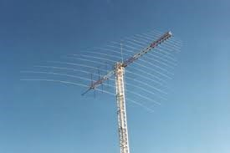
Directional Antennae
A typical directional antenna will have 60° coverage
Need to point in right general direction
Pointing too accurately might give away information in bad way
Can also used set of fixed directional antennae providing 360° coverage
Selecting right antenna is faster than moving a rotate-able one

Slide 9
Dedicated Shore System
If shore can dedicate an antenna to a single MU
Just need to keep it roughly aligned to where MU is
Changes over hours (plane) or days (ship)
Problems to solve
Where is the MU?
Control of Antenna
Which antenna to control
Model suggested is Control at STANAG 5066 Layer
Makes solution application independent
Makes solution ALE unit independent
Keeps MU location information red side

Slide 10
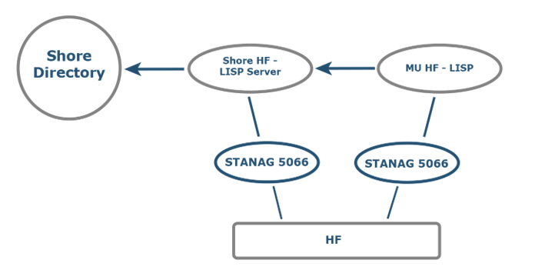
Locating the MU
HF Location & Information Sharing Protocol – HF-LISP (S5066-APP10)
Provides a means of red-side sharing of MU location
Can share link with other STANAG 5066 Applications
Proposed as new Annex for STANAG 5066 Ed5
Recommended approach is to store MU location (and speed/bearing if available) in ACP 133 Directory
Means of sharing location with systems on shore

Slide 11
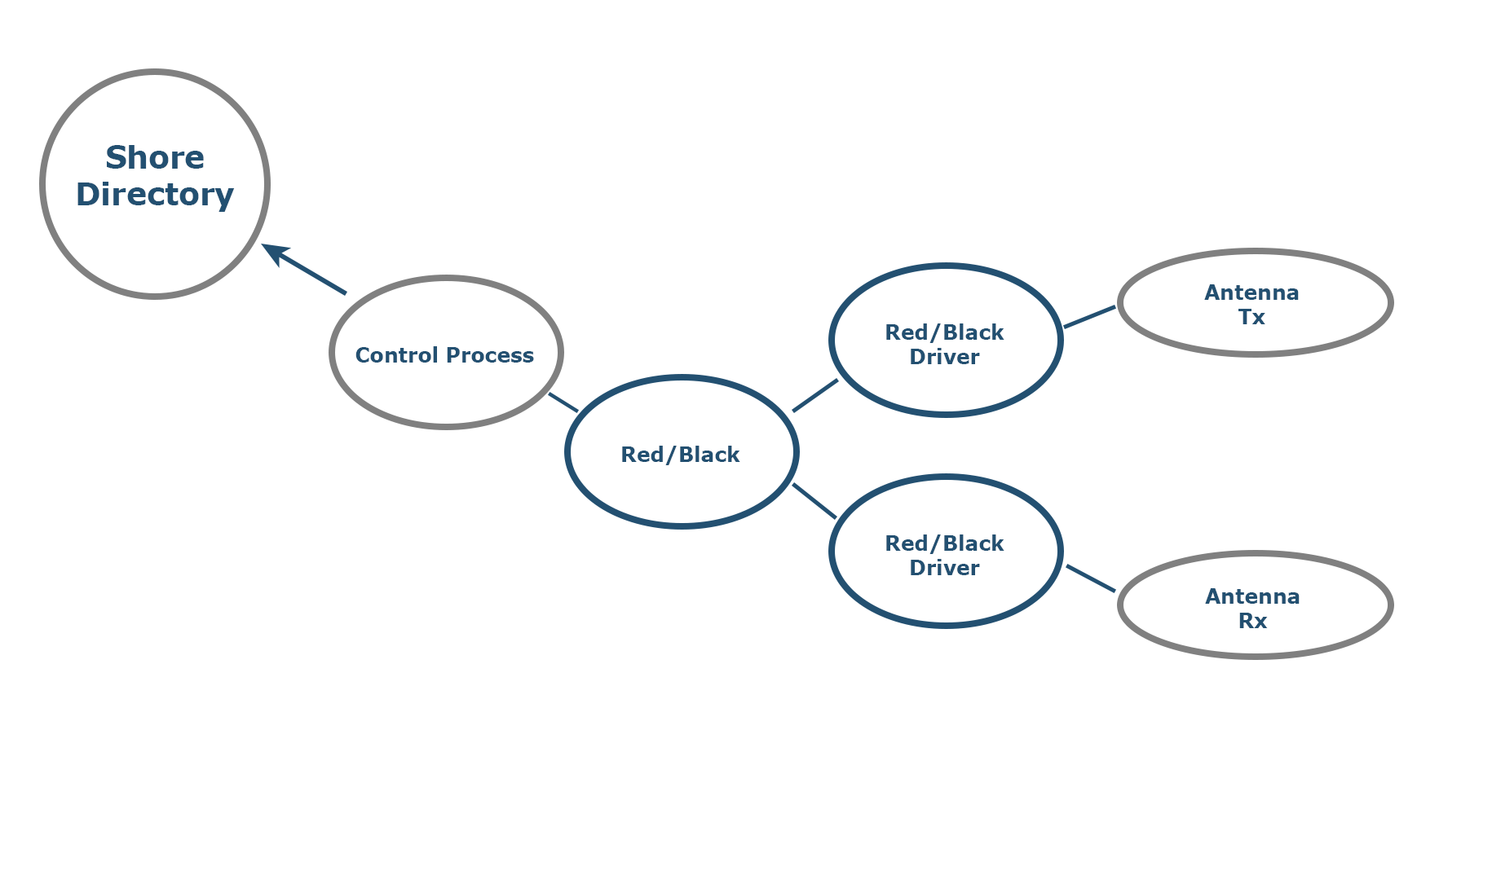
Controlling the Antennae
Red/Black is Isode’s product for monitoring and controlling black side products (such as antennae) from red side
It can provide an abstract control interface onto different antenna controls
Control process can use location of MU (from directory) to move Rx and Tx antennae

Slide 12
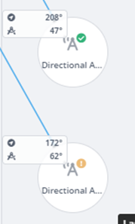
Red/Black Operator Montoring
As well as controlling the Antennae, Red/Black can provide operators with information as to where each antenna is pointing

Slide 13
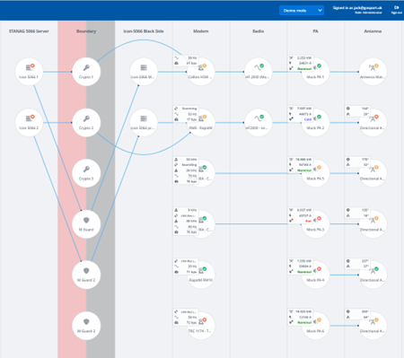
Knowing Which Antennae to Move
A typical shore system will have many antennae with adaptable configuration
Control process can use information from Red/Black to determine which antennae are currently connected to a given STANAG 5066 server
Red/Black can also be used to switch in antennae
When model is to select antenna pointing the right way

Slide 14
Sharing Antennae: Shore Initiated Links
When antennae are shared, shore system needs to select or direct antennae prior to initiating call
STANAG 5066 layer can do this:
Identify MU from STANAG 5066 Address
Look up MU Location in shore directory
Identify and control antennae using Red/Black

Slide 15
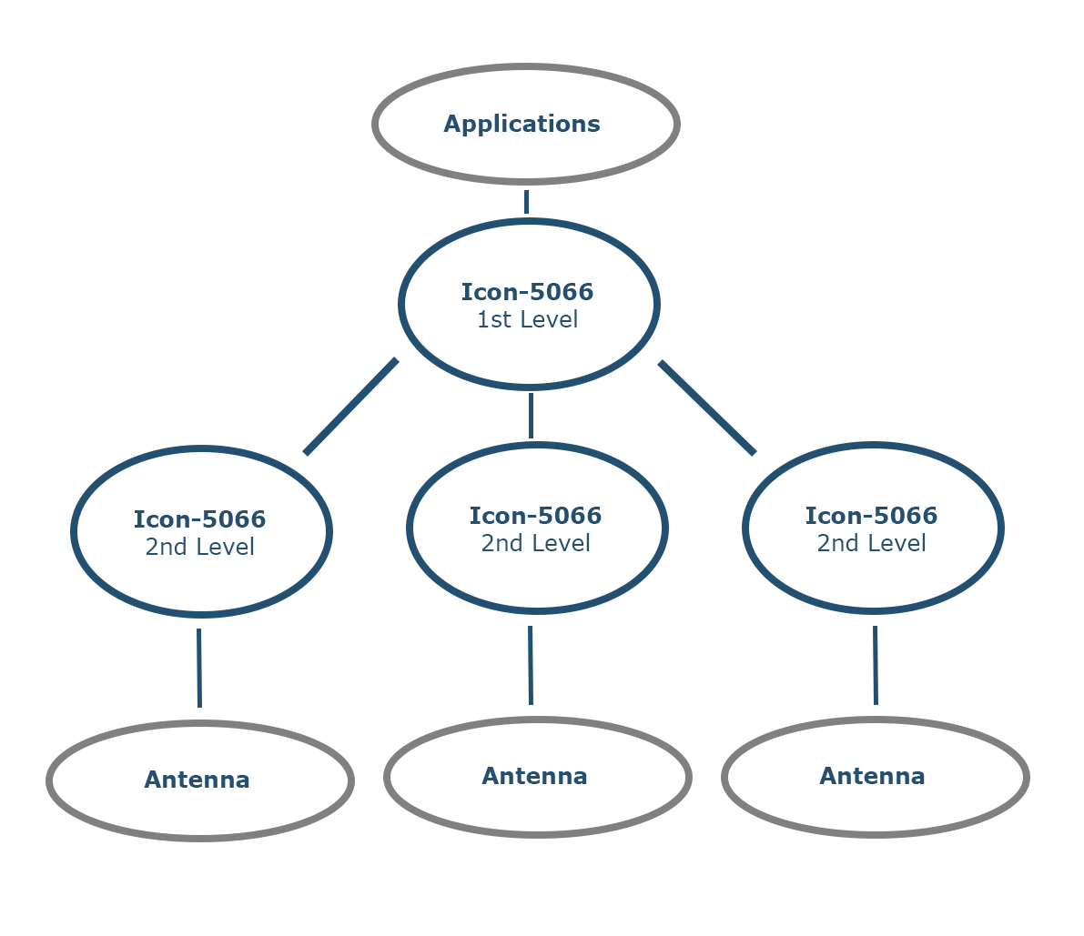
Managing an Antennae Pool
You need one STANAG 5066 server per active antenna
Desirable to make antenna choice transparent to applications
Solution is a hierarchy of STANAG 5066 servers, where “top node” assigns traffic
Hinted at in STANAG 5066 description of ALE 1:1 mode

Slide 16
Sharing Antennae: MU Initiated Links
This needs to provide an automated version of the BRASS Ship to Shore
Receiving system needs to listen (ALE Scan) on omnidirectional antenna
This will be used for ALE Link establishment and initial application data
When shore system has “CAS-1 turn” correct antennae direction (or selection) can be made
MU will just be waiting for data
Could be optimized by MU knowing to initially send minimal data at low speed and to expect to wait

Slide 17
Summary
This paper has set out a model for use of directional antennae with STANAG 5066 and ALE
Isode provides a number of building blocks that could be used to support this
We are keen to work with others interested in a solution here

Slide 18
Thank you for your time
Any Questions?

