Slide 1
HFIA 2020 Annual Meeting San Diego California
Presented By:John Rosica
Date:March 4, 2020
Contact: John.Rosica@Codanconsultant.com

Slide 2
CODAN LIMITED
Innovation wherever you are

Slide 3
Backed by the codAn group
INNOVATION WHEREVER YOU ARE
Codan has over 60 years experience delivering the best products and solutions globally

Slide 4
Backed by the codan group
A REPUTATION FOR PERFORMANCE
Our core values are:
Customer-driven
Can-do
High- performing
Open and we act with integrity
As a publicly listed company with a diverse product mix, we can endure change in global economic markets.
We have a responsibility to our customers and shareholders to uphold our core values in everything we do.

Slide 5
CODAN LIMITED: OUR VALUES
For 60 years we’ve reflected a culture of innovation and diversity, our values communicate that we strive to achieve success through determination and courage, committing to achieving our goals and continuously improving and embracing change.
Creating diversity in our business ensures that we benefit from a wide range of talent, experience, skills and perspectives.
INNOVATION
TALENT
Notes:
Placeholder image until HR photoshoot

Slide 6
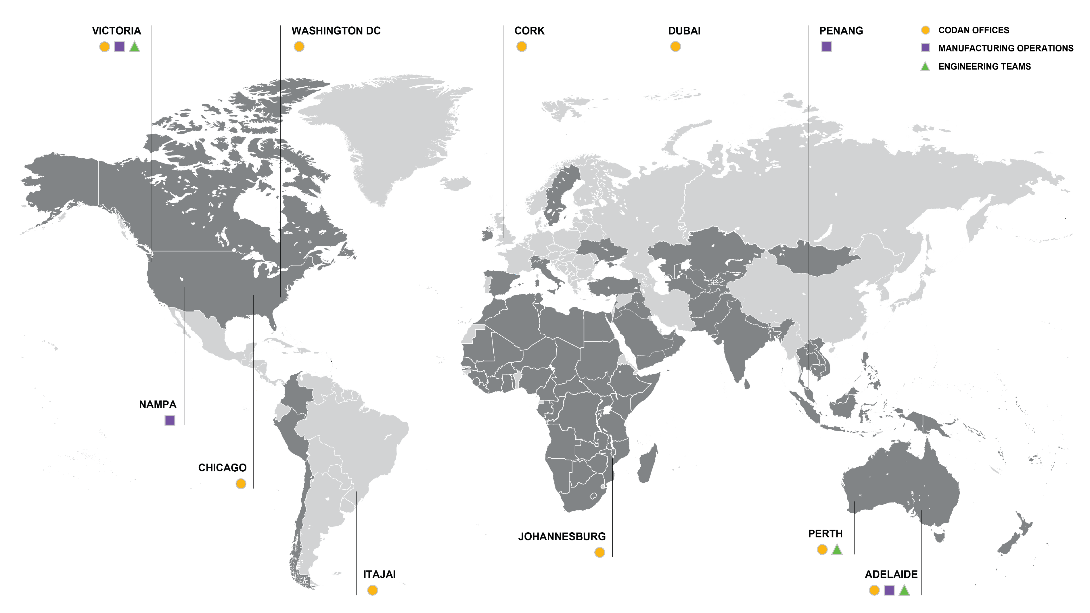
CODAN LIMITED: GLOBAL LOCATIONS

Slide 7
CODAN LIMITED: REVENUE

Slide 8
CODAN LIMITED: TECHNOLOGY
TECHNOLOGY
INNOVATION WHEREVER YOU ARE
Codan was formed over 60 years ago by three engineers who graduated from Adelaide University and then developed long range (HF) radios for the School-Over-the-Air program and later the Royal Flying Doctors. From these humble beginning Codan has developed into a world-class global technology organization with fundamental STEM capabilities in our DNA.
These capabilities combined with the requirements for low-power and low-cost hardware used in remote and harsh environments means that Codan can offer an incredible depth of technical experience across areas such as technology development, product development, system integration, test and validation.

Slide 9
CODAN Ltd: EMPLOYEES
PhD’s held by Codan employees
Notes:
Positive facts about codan, Comparison with other companies

Slide 10
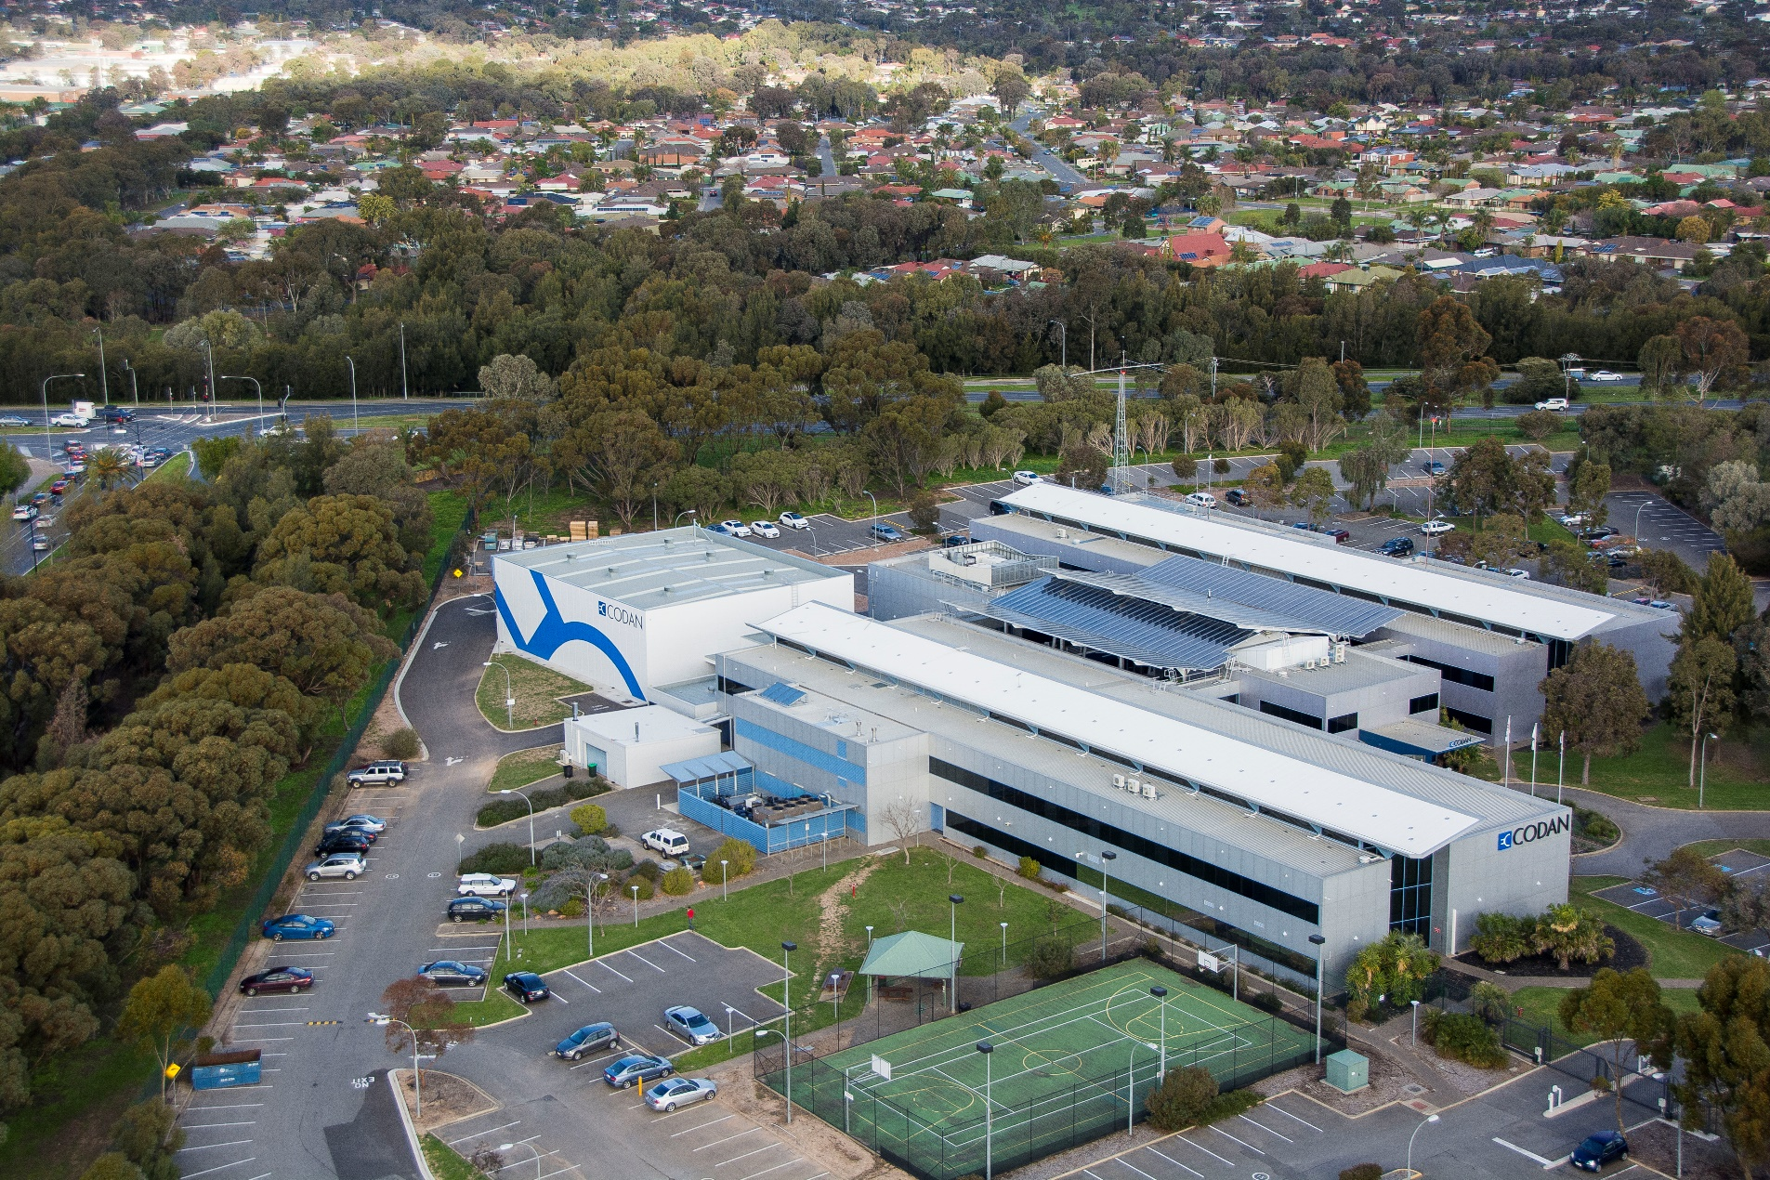
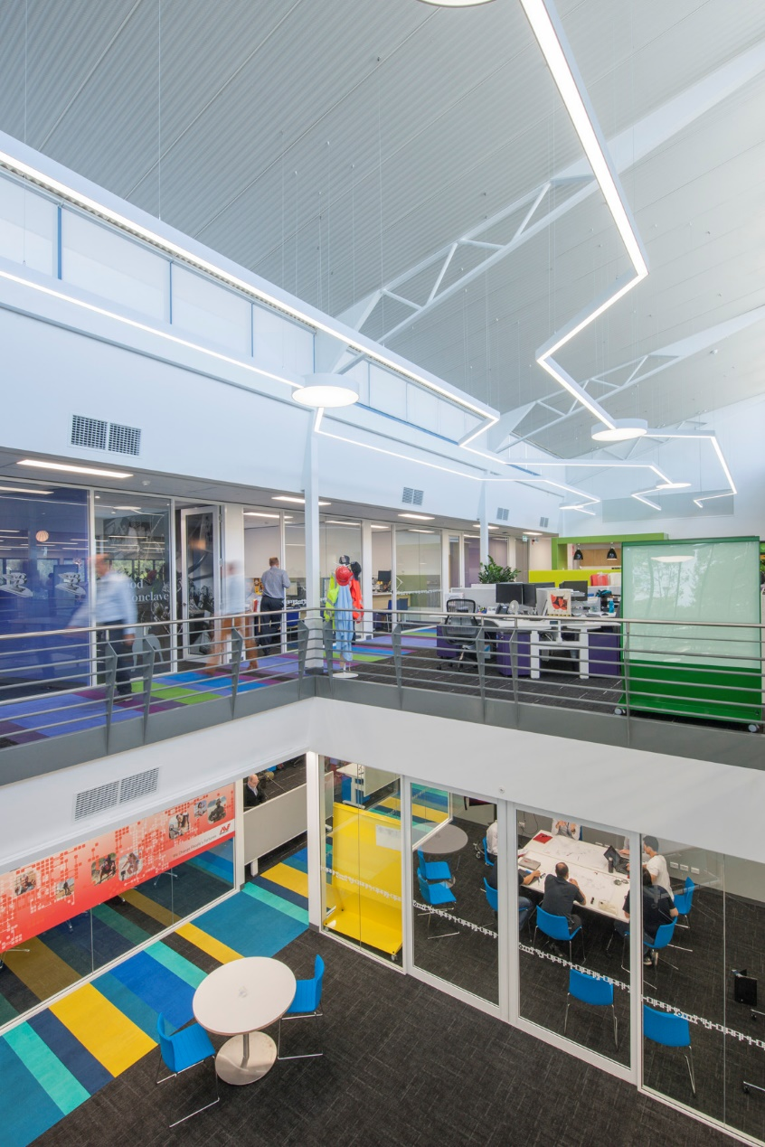
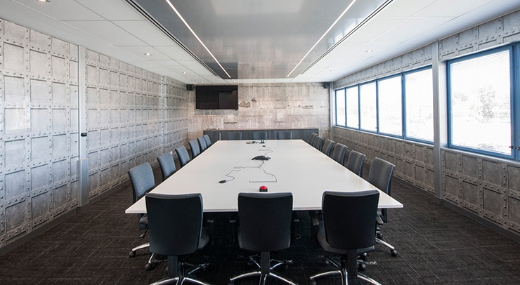
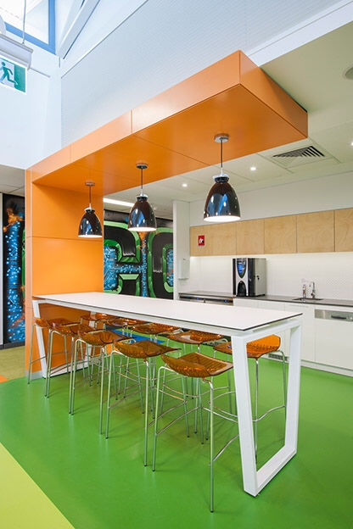
FACILITIES
World class facilities
Notes:
Still need to work…

Slide 11
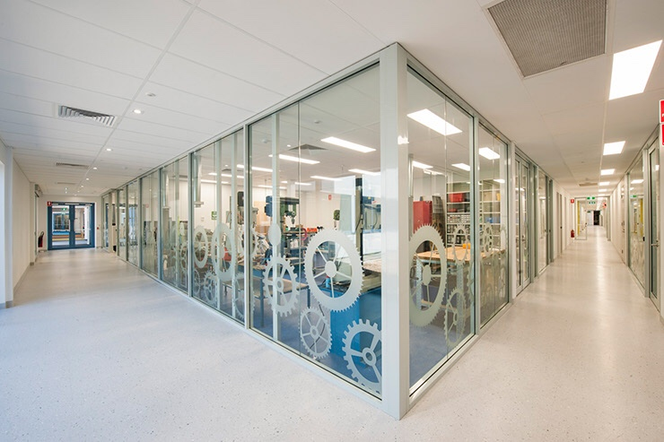
Manufacturing
Warehouse Footings = 900m2
Factory Footings = 1800m2
Notes:
Still need to work…

Slide 12
CORPORATE GOVERNANCE AT THE CORE
Codan strongly advocates good corporate governance and is committed to fulfilling its corporate governance obligations and responsibilities in the best interests of the company and its stakeholders.

Slide 13
OVER 60 years
Under the name Eilco, Codan
is founded to provide electronics
in rural Australia, the harshest
environment on earth
1959
OF PROVEN PERFORMANCE
Codan powers the Royal Flying
Doctor Service, a rural paramedic
service in Australia
1970
1975
After seeing successes in Australia, African companies begin choosing Codan
Codan builds a domestic satellite system and supplies engineers to assist in developing a terminal for Australia’s Aussat satellites
1979
Collaborating with companies across the US, Codan establishes a satellite telephone service for the South Pacific
1989
1998
Notes:
Still in progress

Slide 14
OVER 60 years
1989
Codan acquires MITEC, a Brisbane based company specialising in microwave RF design
1998
Codan expands into military technology, launching a suite of products for HF radio communications
2006
Codan launches a new transpacific military and security division to service worldwide defence and government operations
2009
Codan wins Australian export award for information and Communication Technology (ICT)
2011
Codan acquires Daniels Electronics, a designer of LMR products
2012
2014
Notes:
Still in progress

Slide 15
OVER 60 years
2012
Codan opens new sales office in Dubai and releases upgraded digital voice capability — a game-changer for HF radio
2014
Codan Radio win contract to supply radio repeaters to all forest regions throughout the US
2016
2019
Codan Communications went through a re-brand
Codan launches the new Sentry-H 6110-MP Manpack
2019
2019
Codan Communications landed the biggest order in history to date
2020
Notes:
Still in progress

Slide 16
CODAN COMMUNICATIONS
Who we are

Slide 17
CODAN COMMUNICATIONS
EVERY DEPLOYMENT OF A COMMUNICATIONS SOLUTION IS DIFFERENT.
We know. We deploy in more than 100 countries, from Somalia to Australia. And when lives are on the line, it’s critical that each deployment is right and that every stakeholder is heard.
That’s why it’s important to truly understand your situation, your infrastructure, your environment and your partners.
At Codan Communications, that’s what we’re best at.
Not fitting your situation into our products, but really understanding what’s at stake and tailoring solutions and resources.
So whenever you work with Codan, you know that right from the start, you’ll be heard.

Slide 18
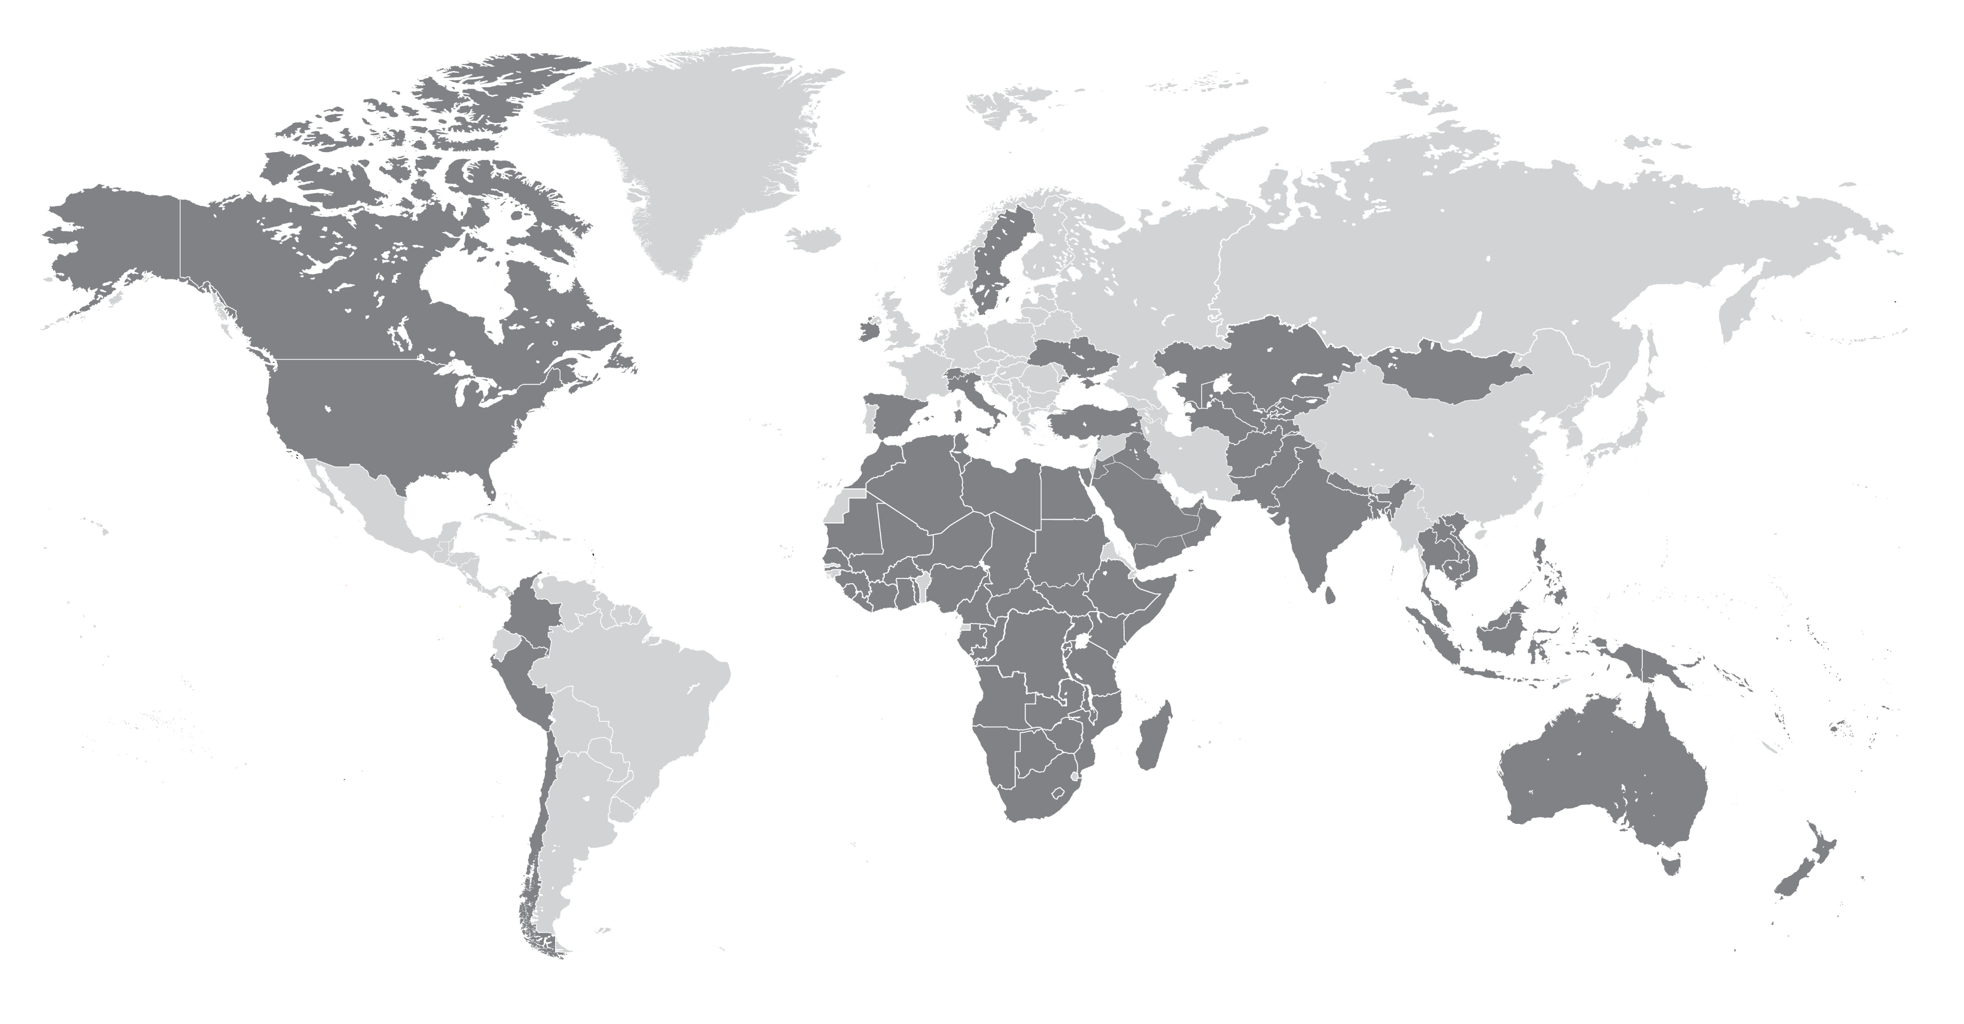
WHERE WE GO
You’ll find our engineers in the harshest environments on earth. In fact, that’s where they thrive.
So while you’ll find our offices in major cities around the world, you’ll find our team on the ground in more than 100 countries.

Slide 19
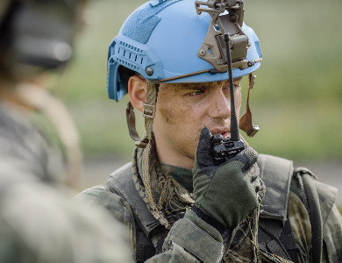
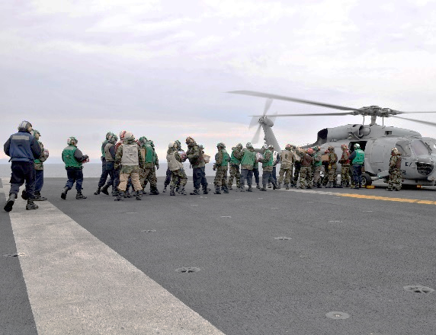
Codan communications
Military
Domestic Security
Peacekeeping
Humanitarian
Commercial
We deploy in more than 100 countries, from Africa to Australia to the United States. We know it’s critical that each deployment is right and that everyone is heard.
We understand what’s at stake to ensure you’ll always be heard.
Notes:
Need to improve the images here

Slide 20
WHY PARTNER WITH US
We go where you go so your people can always be heard

Slide 21
NEW STRATEGIC PARTNERSHIP
Codan Communications announces NVIS Communications as primary partner
for the United States, Mexico, and Caribbean.
29 January 2019
Continuing to build its world class partnership network, Codan Communications is pleased to announce its new primary partner for the US, Mexico and Caribbean - NVIS Communications. Partnering with Codan was the next logical step for NVIS Communications to strengthen and diversify their offering to satisfy customer needs.
“NVIS has a very strong footprint and knowledge of HF Systems Integration and has always respected the reliability and quality of Codan’s products, in particular the engineering and support they offer. Codan’s strategic goals closely align with NVIS and we are very pleased to be working exclusively with Codan worldwide”, stated John Rosica, President of NVIS Communications LLC.
Throughout its long history, Codan has worked extensively alongside its partners worldwide to identify customer needs and ensure that its solutions meet their requirements. “Codan acknowledges its success through its partners and this appointment of NVIS Communications is significant for Codan’s continuing success in the Americas”, stated Michael Demos, Regional Sales Director, Americas.

Slide 22
THE CODAN Communications ADVANTAGE
CODAN SOLUTIONS
Affordable
Codan supplied radios are generally less expensive than most alternative vendors, in some cases, we provide the similar functionality for 30% of the cost of some vendors.
Our brand is associated with quality and value for money, this will enable a capital budget to stretch further without denying operational capability.
Easy to Use
Our products are intuitive to use, easy to train on and provide simple solutions to complex communications problems.
Native language options are a major end-user enabler, require minimal time and cost.
Our products are backward and forward compatible with a proven history of interoperability with multiple vendors.
Support & Services
Based on this solid heritage Codan now exports to more than 100 countries with particular emphasis on:
Africa
Middle East
Central Asia
Asia-Pacific
To date Codan has fielded over 250,000 radio units worldwide.

Slide 23
THE CODAN Communications ADVANTAGE
CODAN SOLUTIONS
Sustainable
With a history of reliability in challenging environments, local language support, ease of use and an unrivalled MTBF rate our products lead the way in sustainability.
With our commitment to local presence and resources, focus on Train Advise and Assist (TAA) models and 3-year in-country warranty, our after sales support is beyond reproach.
Operationally Capable
The proposed solutions are software defined (SDR) which enables a feature rich capability that compares with or exceeds our competition.
Codan understands that security is critical to many of our users and their missions and our radios have AES-256 encryption with resilient OTAZ capability.
Committed Service Examples
Codan has over 60 years experience as a trusted partner of many leaders and users throughout multiple global national defence and security forces.
Codan has supplied over 20,000 radios during this time and continues to install communication solutions, deliver in-country training and mission.

Slide 24
Challenging requirements?
NO PROBLEM
With deployments in more than 100 countries, we have a wealth of knowledge and experience. Time and time again, our clients face similar tough challenges. That’s why we’ve developed expertise in creating communications solutions for when you need…
…interoperability
between multiple communication networks, including legacy systems
…no-gaps in communication
communication from 0 to 3,000 miles and beyond
…rapid responses
to disaster and conflict areas by deploying equipment within as little as 24 hours
…a custom solution
that meets your operational needs
…support and training
available anywhere, within 24 hours
…continuous operations
in the harshest environments on earth

Slide 25
The codan communications process
SOLVING CHALLENGING REQUIREMENTS IS WHAT WE DO BEST
Where others will ask you to change your operating procedure to accommodate their radio systems, we start by truly understanding your situation before assembling the solution that does the job you need.
Assess
Design
Deploy
Train
Support
Our solution consultants conduct a detailed assessment of:
Existing infrastructure
Operational environment
Opportunities and challenges
Stakeholder needs
Budget and existing investments
Our consultants design a custom solution for those challenges, using the right technology from Codan or one of our partners.
Wherever you are, our specialists get your system up and running quickly.
Our consultants are here to train your operators and staff on the technology – to maximize easy-to-use systems and interfaces.
Whether we’re out in the field with you, or in our support center, we’re always on hand for any advice you require.
Notes:
Images fuzzy – looking at improving

Slide 26
Design & development
Specialists in:
RF system design
High performance, low power transmitters and receivers
Low power, low cost and low noise analogue electronics
Digital voice/low bitrate vocoders
Embedded Systems: electronics, firmware and application software
Xilinx and Altera FPGA programming for real time signal processing
Packaging of sensitive electronics for harsh environments
Anti-counterfeit, IP protection and tamper-proofing
Design and test for regulatory and EMC compliance
Comprehensive global product support capability
Design
Notes:
Need to source a development icon too

Slide 27
Through life support
One stop shop for your in-country support
Financially secure, independent and stable business partner
Well equipped, modern test and repair capabilities
Obsolescence management
Training and technical publications
Dedicated classroom training environment
Comprehensive warehousing facilities
Field service engineering with a global footprint
SUSTAINABLE
Notes:
Need to source one more icon here too

Slide 28
COMPONENTS OF YOUR SOLUTION
Products and Features
Notes:
Logo etc..

Slide 29
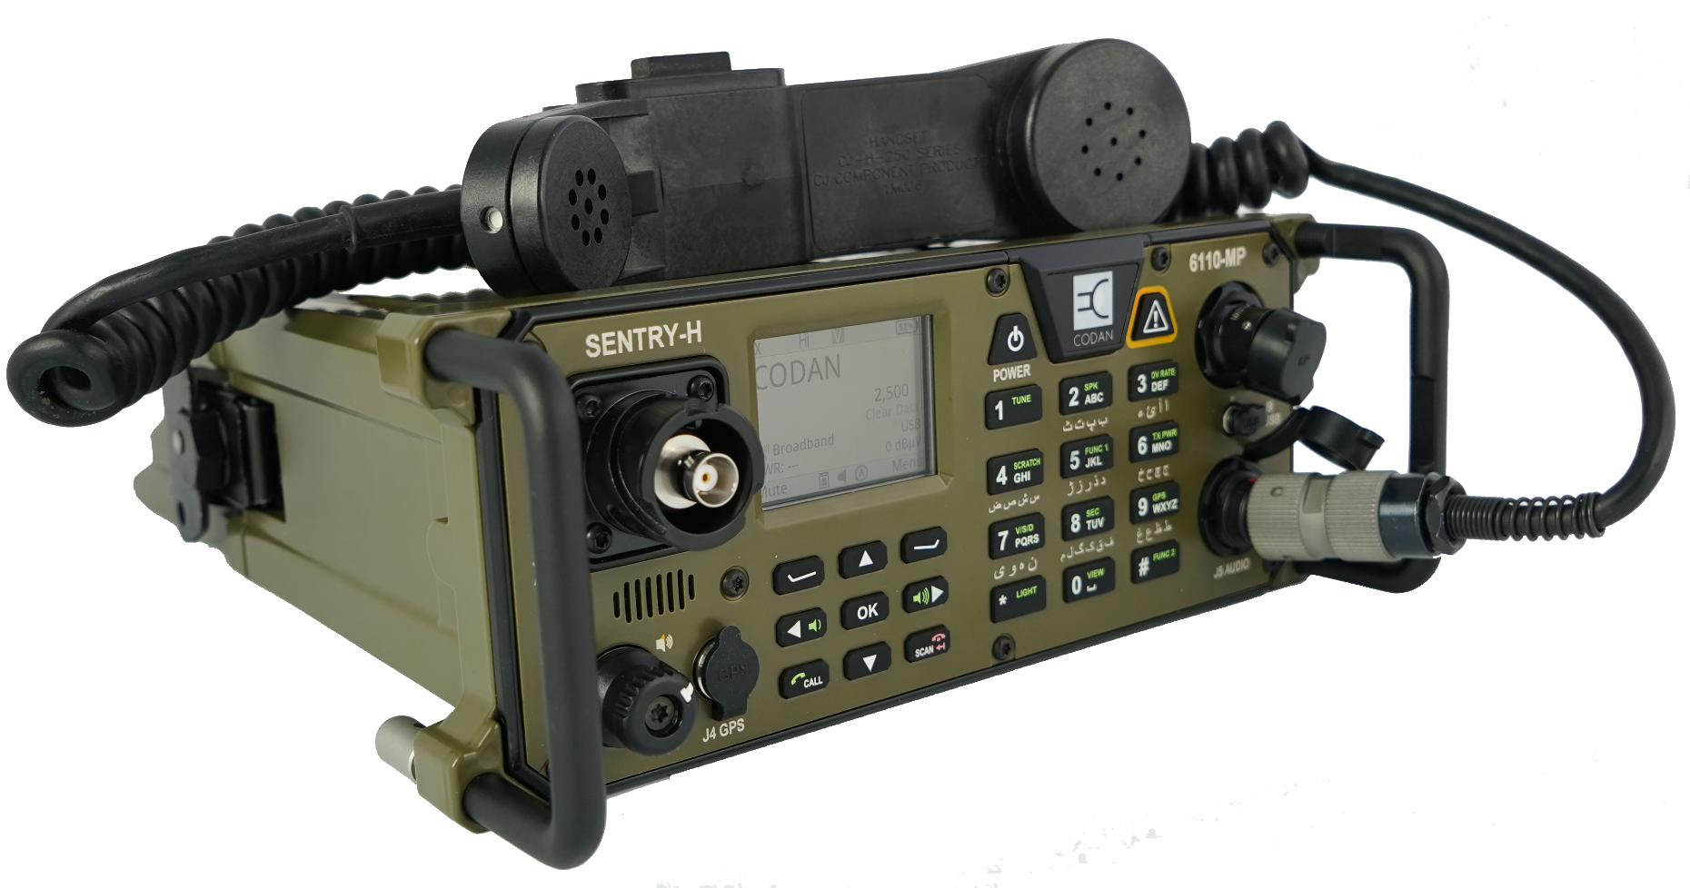
Components of your solution
SENTRY-H 6110-MP
30 W POWER, UP T0 79 HOUR BATTERY LIFE, WEIGHING 4.7KG
Features:
One of the smallest, lightest form factor manpack HF radios available
Built on the latest-generation high performance Digital Signal Processor (DSP), Field-Programmable Gate Array (FPGA) and system on chip (SoC) technology
Second generation Digital Voice coupled with AES-256 encryption provide superior and secure voice quality and data
Built in speaker and GPS
Highly flexible and configurable platform
Provides dual handset control along with being fully compatible with the 2320 Smart Handset
It works well with:
2320 Handset
Tactical antennas
Portable masts
Sentry-H 6120-BM
SprintChat/SprintNet
VCP
RTS
Codan Chat

Slide 30
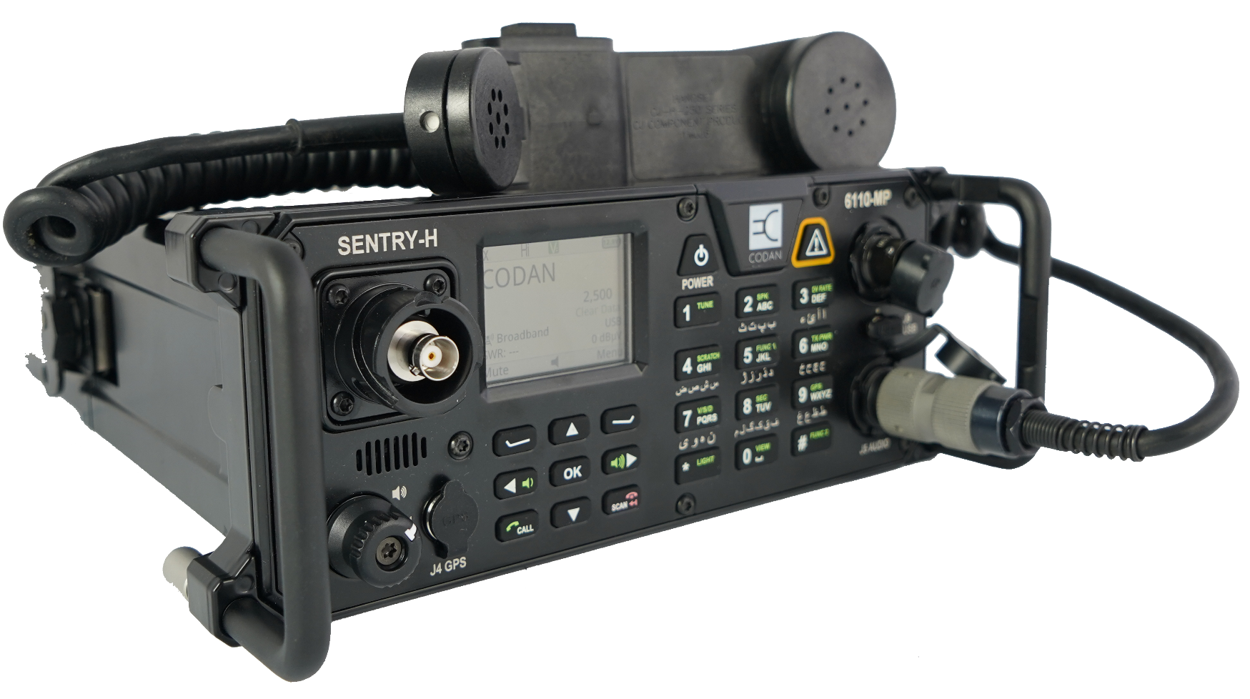
Components of your solution
SENTRY-H 6110-MP
30 W POWER, UP T0 79 HOUR BATTERY LIFE, WEIGHING 4.7KG
Features:
One of the smallest, lightest form factor manpack HF radios available
Built on the latest-generation high performance Digital Signal Processor (DSP), Field-Programmable Gate Array (FPGA) and system on chip (SoC) technology
Second generation Digital Voice coupled with AES-256 encryption provide superior and secure voice quality and data
Built in speaker and GPS
Highly flexible and configurable platform
Provides dual handset control along with being fully compatible with the 2320 Smart Handset
It works well with:
2320 Handset
Tactical antennas
Portable masts
Sentry-H 6120-BM
SprintChat/SprintNet
VCP
RTS
Codan Chat

Slide 31
Components of your solution
SENTRY-H 6120-BM
A RUGGED AND AFFORDABLE RADIO SOLUTION
Features:
Built with ruggedness and reliability as a focus
Exceptional Digital and Analogue voice clarity
Built on the latest-generation high-performance Digital Signal Processor (DSP), Field Programmable Gate Array (FPGA), and system on chip (SoC) technology
AES-256 encryption provide superior and secure voice quality and data
Intuitive user interface that can be switched into various languages
Integrated solution into a single compact unit
Related Products:
2320 Handset
3320 Transceiver Supply
500W / 1kW High Power Amplifiers
3033 Telephone Interconnect
3031 Crosspatch
Smartlink
Tactical antennas
Portable masts
XTEND Smartphone app
VCP

Slide 32
Components of your solution
SENTRY-V 6150
SECURE AND MISSION READY
Features:
Field proven Rugged design for reliability in the harshest environments
Secure communications with AES-128 encryption
Backlit LCD display
Squelch control with power-saving mode
Available in hand held, man-portable, vehicular and base configurations.
Advanced features such as Data transmission, AES 256 Encryption and Frequency Hopping.
It works well with:
Codan RIOS to enable extension into HF, PSTN, cellular and VOIP networks
Fist mic
Headset with PTT

Slide 33
Components of your solution
SENTRY-U 6160-PR
ACTION ON THE FORWARD EDGE
Features:
Provides Inter and Intra team communications.
Compact and lightweight
Secure communications with AES-128 encryption
Wireless PTT operations
Full duplex digital voice communication (conference mode)
Built in GPS
LPD waveform
It works well with:
Codan RIOS to enable extension into HF, PSTN, cellular and VOIP networks
Fist mic
Headset with PTT

Slide 34
Components of your solution
SENTRY-U 6160-PR
ACTION ON THE FORWARD EDGE
Features:
Provides Inter and Intra team communications.
Compact and lightweight
Secure communications with AES-128 encryption
Wireless PTT operations
Full duplex digital voice communication (conference mode)
Built in GPS
LPD waveform
It works well with:
Codan RIOS to enable extension into HF, PSTN, cellular and VOIP networks
Fist mic
Headset with PTT

Slide 35
Components of your solution
RIOS
ANY DEVICE INTEROPERABILITY
Features:
Tactical interoperability unit with eight high-density interface ports within an environmentally protected FAA-compliant transit case
Interoperability for all types of communications including HF, VHF, UHF, 700/800 MHz radio, cellular or satellite phones and computers.
Immediate deployment in any environment
Highly-efficient network integration provides global coverage with Ethernet, satellite or wireless IP
It works well with:
Envoy X1 and X2 HF radio
Sentry-H 6120-BM HF radio
Sentry-V VHF radio
Patrol 2110 / 2110M

Slide 36
Components of your solution
ENVOY
THE EASIEST TO USE HF RADIO
Features:
Fast linking and secure data messaging with 3G ALE
Set attributes with HF Secure Interoperability to match other transceiver encryption settings
Speaking your language with Icon-based full-colour user interface and localised languages minimising the need for user training.
Be heard loud and clear with Codan’s second generation Digital Voice
Software-Defined technology enables software upgrades to future-proof your investment
It works well with:
Xtend Smartphone App
Smartlink
GPS
Codan Chat
VCP
500 W / 1 kW High Power Amplifiers
3061 / 3062 Power Amplifier
3031 Crosspatch
3033 Telephone Interconnect
3020 Transceiver Supply

Slide 37
Components of your solution
PATROL 2110
PORTABLE, RELIABLE, RUGGED AND SECURE
Features:
Be heard loud and clear with Codan’s second generation Digital Voice
Long battery life, up to 65 hours and lightweight 2.9kg design with MIL-STD-810F standards.
Integrated GPS with encrypted position information, no-go proximity warnings and one-button emergency calling
Advanced ALE with capabilities for voice, message, GPS tracking and radio status for simple and reliable communication.
Internal data modem capable of data-rates of up to 9600 bps, secured with AES-256 bit encryption to ensure confidentiality.
It works well with:
Patrol 2110M
2120 Handset
Tactical antennas
SprintNet / SprintChat
GPS
3031 Crosspatch

Slide 38
Components of your solution
PATROL 2110M
PORTABLE, RELIABLE, RUGGED AND SECURE
Features:
Be heard loud and clear with Codan’s second generation Digital Voice
Long battery life, up to 65 hours and lightweight 2.9kg design with MIL-STD-810F standards.
Integrated GPS with encrypted position information, no-go proximity warnings and one-button emergency calling
Advanced ALE with capabilities for voice, message, GPS tracking and radio status for simple and reliable communication.
Internal data modem capable of data-rates of up to 9600 bps, secured with AES-256 bit encryption to ensure confidentiality.
It works well with:
Patrol 2110
2120 Handset
Tactical antennas
SprintNet/SprintChat
GPS

Slide 39
Components of your solution
XTEND
Features:
XTEND your HF network by using your smartphone to control and perform basic HF radio functions
Any-device SMS text displayed in native language through the HF radio
Real-time position awareness
Smartphone capability (Android Operating System Version 4.4 and above iOS Operating System Version 12 and above)
It works well with:
Envoy X1 and X2 HF radio
Sentry-H 6110-MP
Sentry-H 6120-BM
Notes:
apple

Slide 40
Components of your solution
SPRINT APPLICATIONS
MESSAGING CAPABILITY OVER HF RADIO
Features:
AES-256 encryption provides information security for linking and on-air data
3G ALE technology performance gains over traditional 2Gdata solutions
Simple, intuitive user interface with automatic image resizing
Supports commercial POP3 email client applications
SMS text chat and email gateway capability with automatic routing
It works well with:
Envoy X2 HF radio
Patrol 2110 / 2110M HF radio

Slide 41
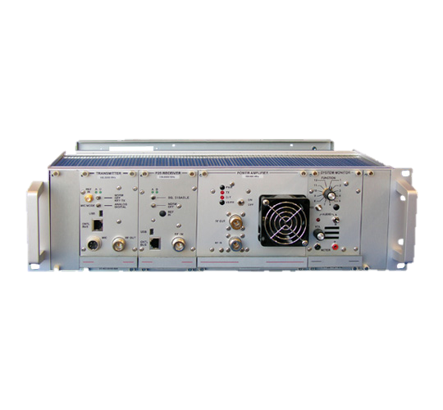
Components of your solution
MT-4E SERIES
RELIABLE & FLEXIBLE ANALOG & P25 INFRASTRUCTURE PLATFORM
Features:
Fully integrated control, RF amplification and DFSI interface in a small 4RU footprint
Network and software driven use and functionality
Standards based, vendor-neutral operation
Typical Applications:
Medium-sized networked radio deployments
Fixed installations
P25 DFSI Base Stations
Voting and Simulcast

Slide 42
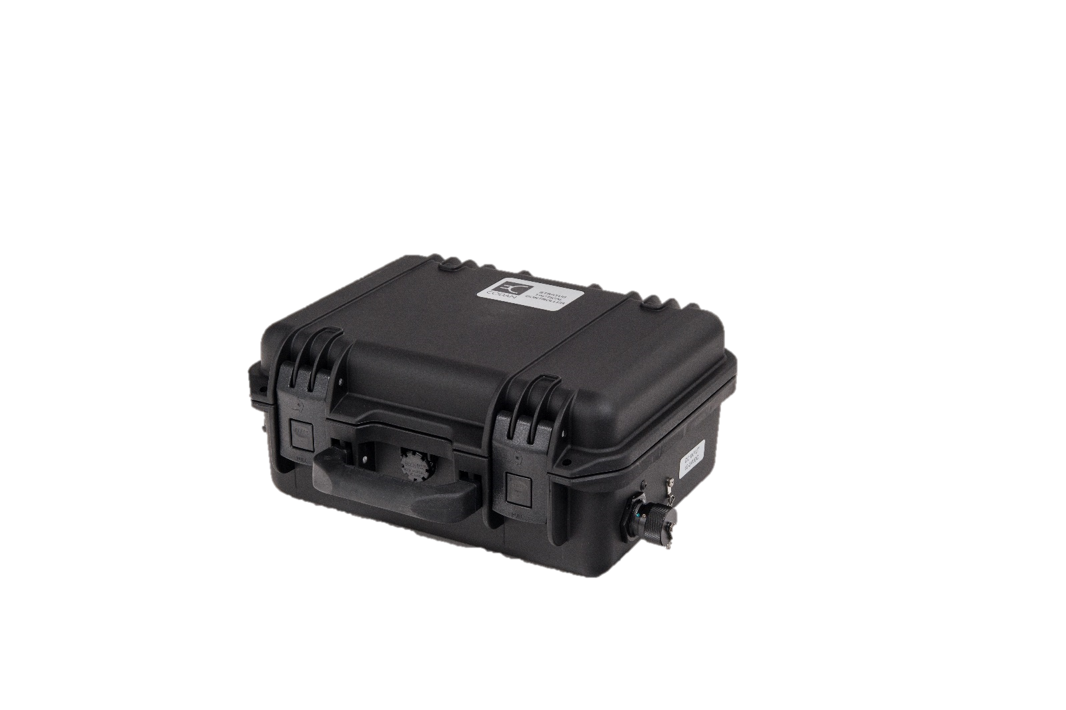
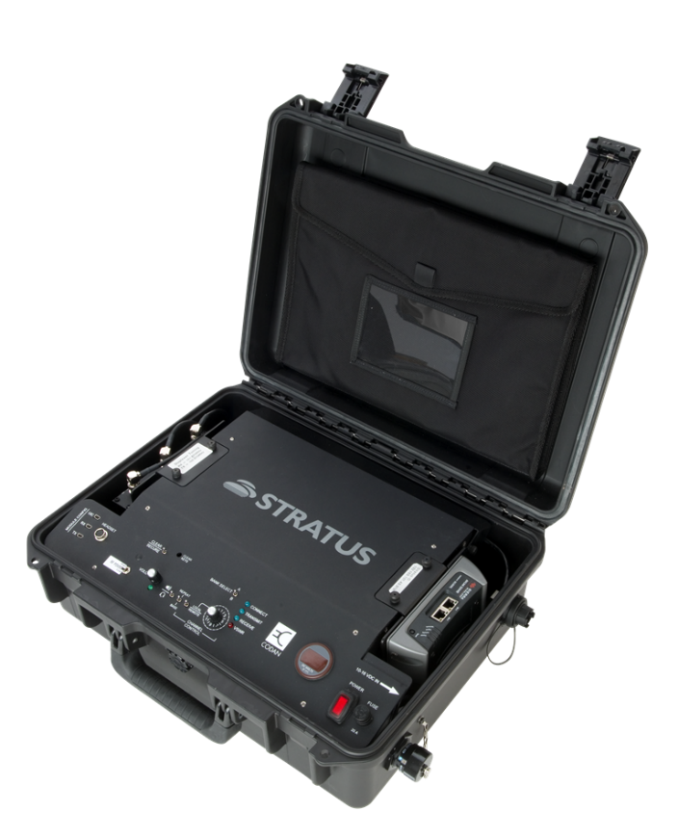
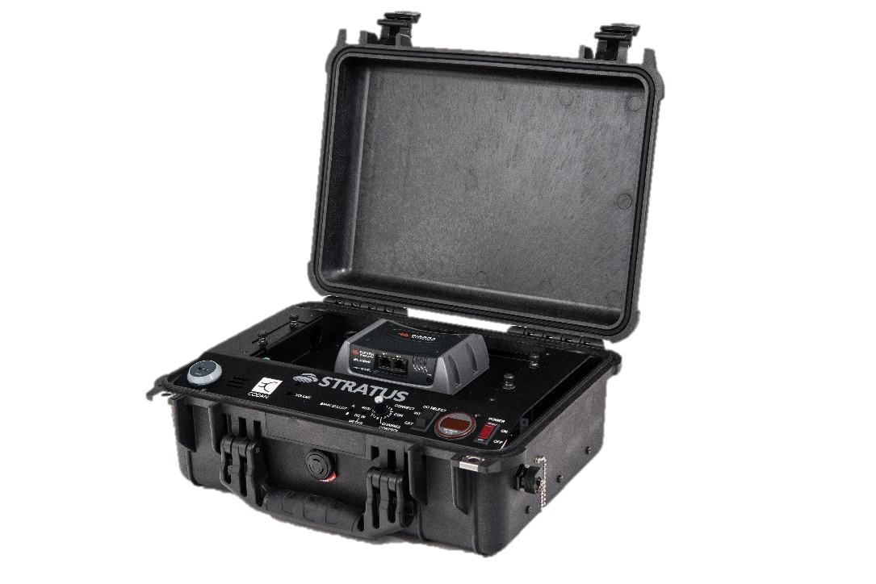
Components of your solution
STRATUS SERIES
ENHANCED LMR COVERAGE LEVERAGING UNIQUE BACKHAUL SOLUTIONS
Features:
Utilizes non-typical IP backhaul transport such as cellular and satellite to provide connectivity and networking to conventional repeaters and base stations
Provide a network of communication that is activated with the flip of a switch virtually anywhere in the world
Management of DFSI connections in a single network
Standards based, vendor-neutral operation
Typical Applications:
Special Event / Tactical deployments
Rapid deployment scenarios
On-the-fly in-fill coverage
Motorola ATAC Voting Core integration via RIC-M P25 to V.24 Conversion

Slide 43
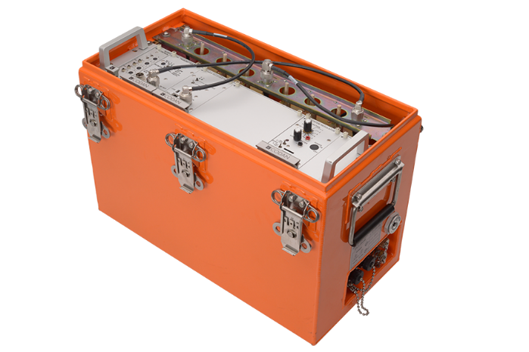
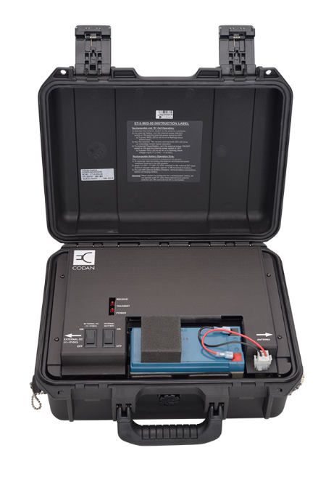
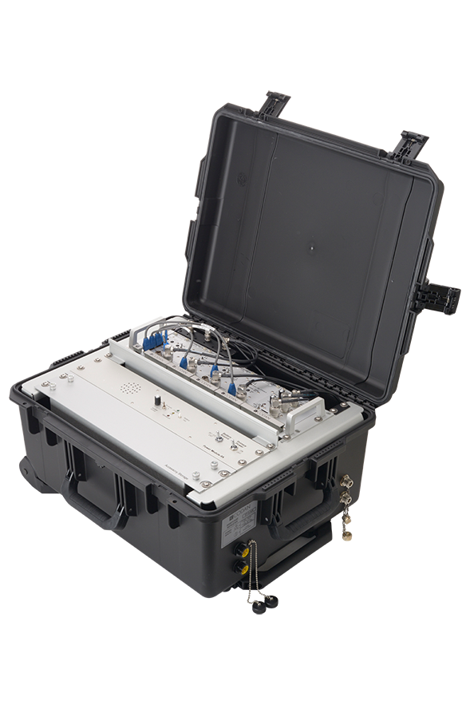
Components of your solution
ET SERIES TRANSPORTABLES
THE MT-4E SERIES INFRASTRUCTURE IN A ROBUST RAPIDLY DEPLOYABLE PACKAGE
Features:
All the benefits of the MT-4E series in a transportable package
All cases utilize proper base station and repeater infrastructure, providing superior performance over handheld or mobile based units
Rugged construction
HiveNet© transportable networking functionality
Typical Applications:
Special Event / Tactical deployments
First Response situational deployments
Rapid deployment scenarios
On-the-fly in-fill coverage
Trunking, Voting and Simulcast

Slide 44
Components of your solution
PAGING
A TRUSTED AND RELIABLE
MASS NOTIFICATION SYSTEM
Features:
Infrastructure based on our robust MT-4E Series infrastructure platform
Multiple Digital paging formats supported, including POCSAG, FLEX, Mark xVx, APOC, etc.
Analog paging support for 2 Tone and 5/6 Tone
Simulcasting options available for multiple stations operating a single frequency
Typical Applications:
Mass notification
Simple remote equipment control

Slide 45
LET’S TALK
We’ll set up a time for our technical consultant to understand your requirements and for you to be heard.
Your closest contact: NVIS Communications, LLC./CODAN Consulting Div.
Phone: 703-729-1068
Locations:
Alaska
Arkansas
California
Florida
Hawaii
Oregon
Texas
Virginia
Washington
Australian Office:
2 Second Avenue
Technology Park
Mawson Lakes, SA, 5095
Dubai Office:
305-306, Tower BB1, Mazaya Business Avenue
Jumeirah Lake Towers
Dubai UAE
US Office:
19955 Highland Vista Drive,
Suite 145 Ashburn VA 20147 USA

