Slide 1
MOSTYN ENTERPRISES
5/12 SEVERN STREET,
St. MARYS, NSW, 2760, AUSTRALIA
+61 (02) 9194 3470
Copyright © 2020 Mostyn Enterprises (Technologies) Pty Ltd
Notes:
Play with fonts

Slide 2
Core
Mostyn Enterprises commenced its manufacturing business operations in 1967. It is involved in the Manufacturing, Design and Integration of Electronic Equipment. It has represented Overseas International Companies for the past 30 years. Its main business has been with the Defence and Dual Technologies sector.

Slide 3
OUR POLICIES
Our policies are:
To design and manufacture leading-edge RF products
To encourage university students to excel in RF technology
To work with local universities in development of products
UNSW and Mostyn Enterprises have enjoyed a multi-year multi-level relationship covering undergraduate and postgraduate internship placements through to active engagement on collaborative research opportunities
We have recently signed a Memorandum of Understanding to anoint the partnership and we look forward to continued collaborations
Notes:
Spread out and add stuff

Slide 4
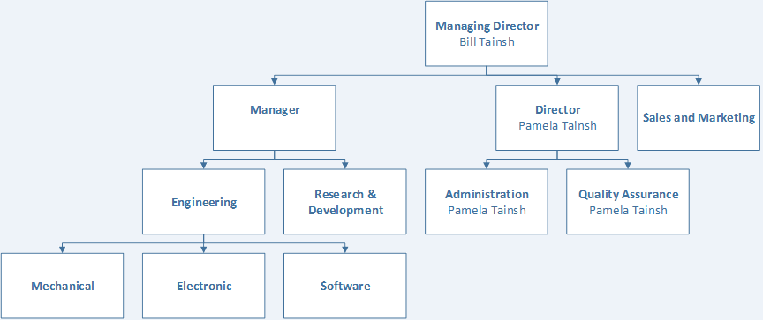
ORGANISATION CHART

Slide 5
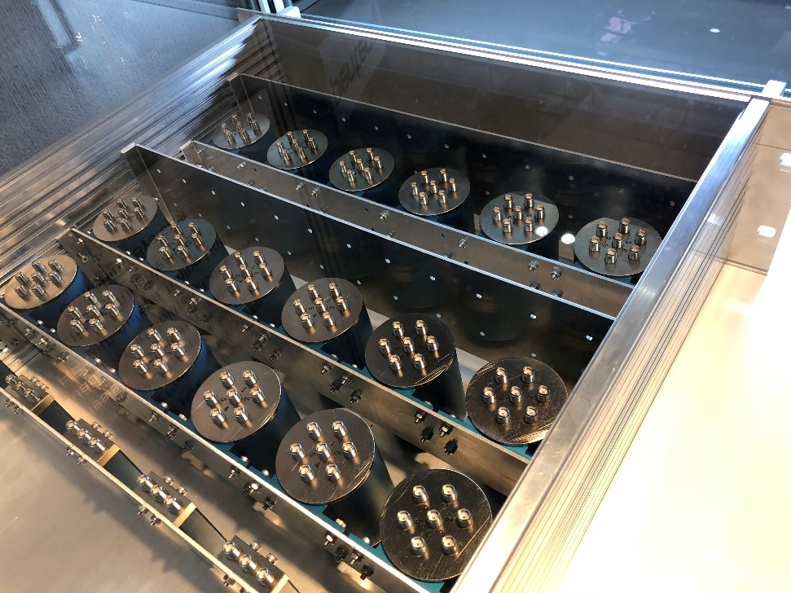
OUR MAJOR PRODUCTS
Listed below are the major products in our range or currently under development:
Matrix Switch 19” rack mount
Matrix Switch vehicle mount
Loop antenna
Power amplifiers
Tuneable filters
PPS (Pre/Post Selector Switch)
Filters
RF switches
Drone barrier system

Slide 6
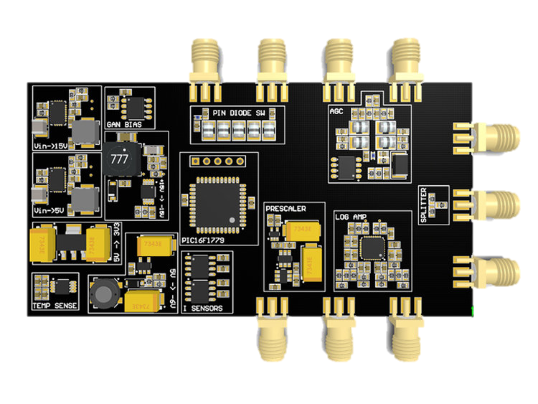
OUR PRODUCTS
Listed below are the minor items:
Directional couplers
Dual directional couplers
Bi-directional couplers
Bias Tees
DC Blocks
Electronic fuse
GaN controller

Slide 7
MATRIX SWITCH 19’’
The purpose of the unit is to provide protection to the RF power amplifiers and/or radios due to damage to antenna systems or connection to inappropriate antennas. This can be used as a standalone product or in conjunction with our tunable filter and/or fixed filters. These units will only be processed as a vehicle mount only.
Switches are available in 4x4 to 12x12 configurations.
Blocking, latching switches to reduce power consumption.
24 – 28V operating voltage.
N type, SMA input and TNC output connectors. Swappable on request.
Features front panel control, RSxxx USB and Ethernet communication.
Frequency range DC - 26.5GHz.
Power rating 4kW @ 1-30MHz, 1kW @ 1.2Ghz.
Suitable for land, sea and air operation.

Slide 8
MATRIX SWITCH VEHICLE MOUNT
Switches are available in 4x4 and 6x6 configurations.
Blocking, latching switches to reduce power consumption.
24 – 28V operating voltage.
N type, SMA I/O connectors. Others available on request.
Features front panel control, RSxxx USB and Ethernet communication.
Frequency range DC - 26.5GHz.
Power rating 4kW @ 1-30MHz, 1kW @ 1.2Ghz.
Suitable for land mobile operation.

Slide 9
LOOP ANTENNA

Slide 10
LOOP ANTENNA MKI
Our MKI loop antenna is capable of providing a self tracking capability, operated in a mobile operation. The technical specifications are as follows:
Two antennas, in either single or double loop configuration
Loop 1, 2-11MHz
Loop 2, 11-30MHz
Dual, 2-30MHz
Capable of traversing 360°, and elevating from 0-90°
Self tracking using inertial measurement unit
Power rating - 1kW
Maximum voltage potential - 30kV
Operates on 24-28V
Communication via USB, Ethernet, RSXXX
Notes:
Degrees symbol

Slide 11
LOOP ANTENNA MKII
Capable of providing over-the-horizon directional communication, using the ionosphere to provide long distance links, operated from a stationary or mobile position. The technical specifications are as follows:
Two antennas, in either single or double loop configuration
Loop 1, 2-11MHz
Loop 2, 11-30MHz
Dual, 2-30MHz
Capable of traversing 360° (MKI), and elevating from 0-90° (MKI)
Self tracking using inertial measurement unit
Power rating - 1kW
Maximum voltage potential - 20kV
Operates on 24-28V
Communication via USB, Ethernet, RSxxx

Slide 12
POWER AMPLIFIERS
Mostyn Enterprises Part # | Description
MEB-1-20M-1G | 1W 20-1000MHz Medium Gain LDMOS-Based RF Module
MEB-1W5-30M-512G | 1.5W 30-512MHz Medium Gain VDMOS-Based RF Module
MEB-8-20M-3G | 8W 20-3000MHz Medium Gain GaN-Based RF Module
MEB-10-20M-2G | 10W 20-2000MHz Medium Gain GaN-Based RF Module
MEB-10-20M-2G5 | 10W 20-2500MHz Medium Gain GaN-Based RF Module
MEB-10-30M-512M | 10W 30-512MHz Medium Gain LDMOS-Based RF Module
MEB-70-1M-1G | 70W 1-1000MHz High Gain GaN-Based RF Module
MEB-80-500M-1G | 80W 500-1000MHz High Gain LDMOS-Based RF Module
MEB-100-0M5-5M | 100W 0.5-5MHz High Gain LDMOS-Based RF Module
MEB-150-30M-512M | 150W 30-512MHz High Gain VDMOS-Based RF Module
MEB-400-2M-30M | 400W 2-30MHz High Gain LDMOS-Based RF Module
MEB-500-1M5-30M | 500W 1.5-30MHz High Gain VDMOS-Based RF Module
Notes:
List ones that are done + 1kW

Slide 13
TUNEABLE FILTER - PPS
There is currently a major problem of co-site interference due to the number of higher-powered radio antennas in close proximity to each other. Due to the increasing bandwidth of radio systems, the complexity of the design has increased. Therefore, there is a need to provide a solution to reduce or eliminate this interference. One of the solutions is a pre-/post-selector switch system based on a tuneable filter/s. In the following slides, we shall show some of the solutions under development at Mostyn Enterprises.
Some of the highlights of our tuneable filter design are:
Single-octave filters
Software-selectable bandwidth
Software-selectable channel spacing/steps
Frequency range: 1MHz – 3GHz
P(max) input: -10dBm

Slide 14
PPS
Looking at tightening drop-off of the filter and increasing attenuation in the stopband
Also looking at different filter types

Slide 15
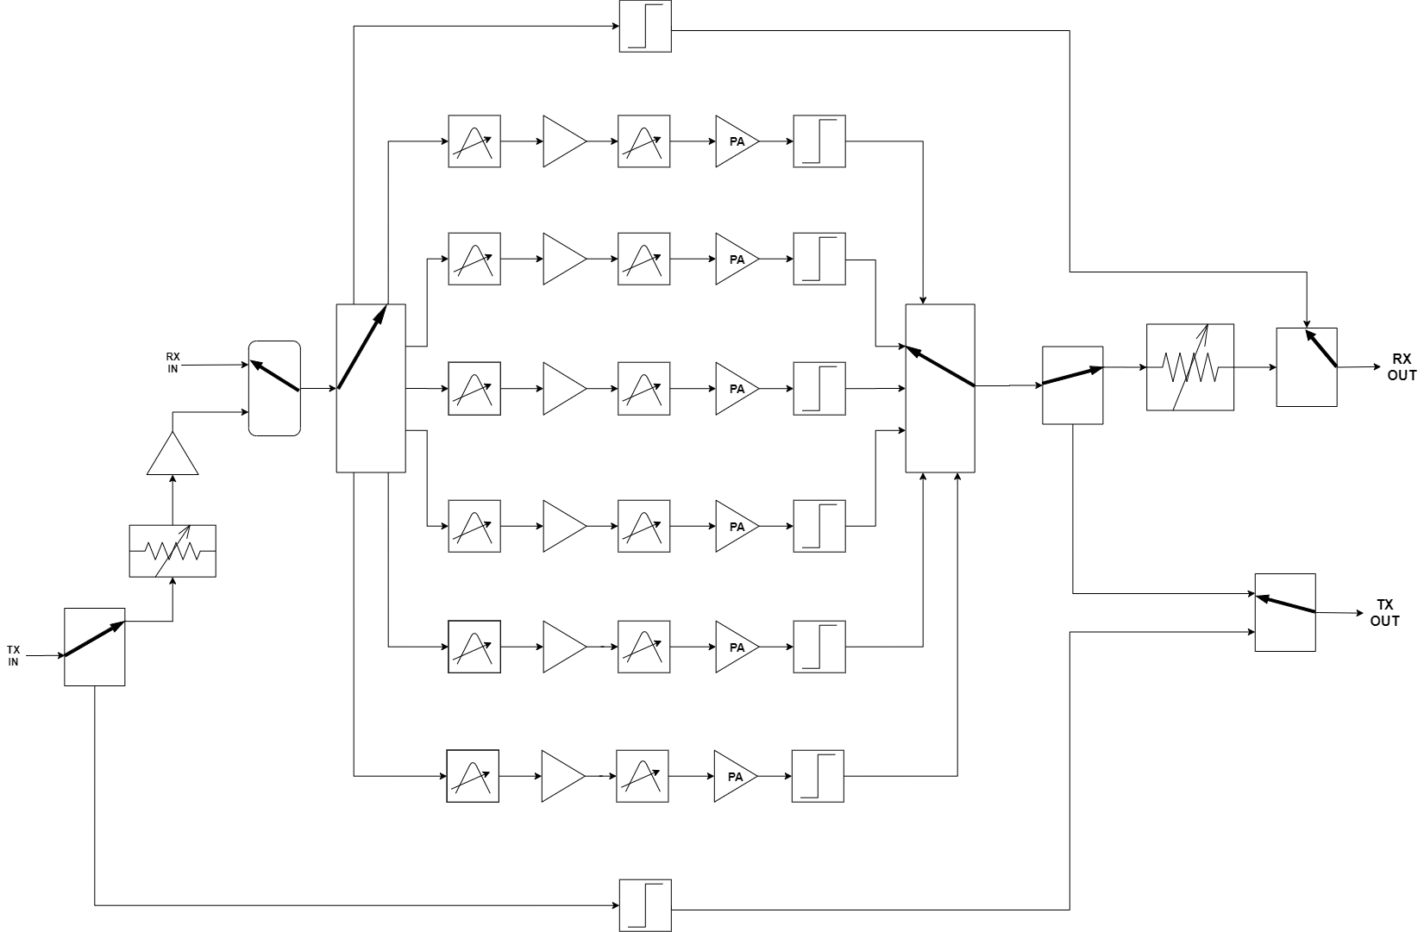
PRE/POST SELECTOR HF

Slide 16
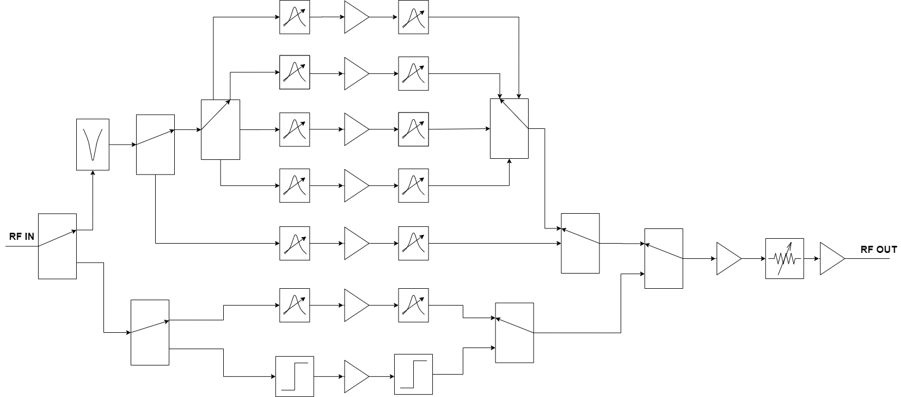
PRE/POST SELECTOR HF (PPS)

Slide 17
FILTERS
Lumped element filters (these filters are available in lowpass, highpass, bandpass and bandstop):
Toroid-based
Frequency range: 1.8 – 50MHz
P(max): 2kW
Air coil-based
Frequency range: 45 – 750MHz
P(max): 1.5kW
Multi-bank filters……….

Slide 18
RF SWITCHES
Mostyn Enterprises have developed a range of manual-selection RF switches and microprocessor-controlled RF switches. The manual version is only available for relays. The microprocessor-controlled unit controls both relays and multi-position selector switches. Currently in development is a range of PIN diode switched attenuators, as an optional extra. The RF switches are available in small desktop, large desktop and 19-inch rack versions.

Slide 19
RF SWITCHES
GENERAL DESCRIPTION
Notes:
Pretty picture

Slide 20
RF SWITCHES
Pictures and renderings

Slide 21
OTHER PRODUCTS
R.F.
Switching Systems
Power Amplifiers
Filters
Splitter/combiners
Resistive
Quadrature lumped element
HF Antenna Tuning Units
Analogue circuit design
Digital circuit design
Systems integration
Navigation systems
Data Logging
Turnkey Solutions

Slide 22
DRONE BARRIER SYSTEM
Mostyn Enterprises are developing a drone barrier system based around their tuneable RF filter and their power amplifiers. The basic system consists of a noise generator/external generator, an 8 Watt or 25 Watt 20MHz – 3GHz PA, a range of block bandpass filters and/or our tuneable filter. We can also supply a PA 30 – 520MHz, greater than 400 Watts.

Slide 23
DRONE BARRIER SYSTEM

Slide 24
Questions
Any questions or comments?
Contact Details
Mostyn Enterprises (Technologies) Pty Ltd
Unit 5/12 Severn Street
St. Marys 2760, Australia
Phone: +61 (02) 9194 3470
Mobile: +61 414 716 311
E-mail: btainsh@mostynent.com
Skype: bill.tainsh

